Slide 1
Convolutional Neural Networks
BIO 4990/6990
March 6, 2024
Dr. Megan Smith
Mississippi State University

Slide 2
Outline
Motivation for CNNs
How do CNNs work?
Examples
Population genetics
Phylogenetics
Species Identification
Tumor Detection and Identification

Slide 3
Outline
Motivation for CNNs
How do CNNs work?
Examples
Population genetics
Phylogenetics
Species Identification
Tumor Detection and Identification

Slide 4
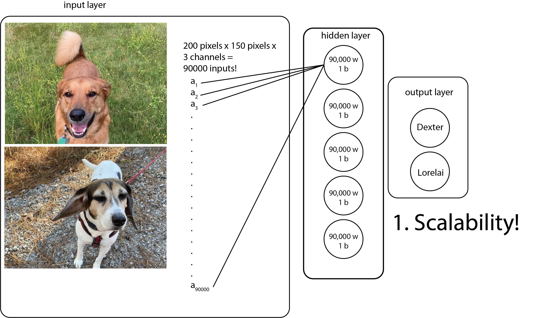
What if I want to classify images?

Slide 5
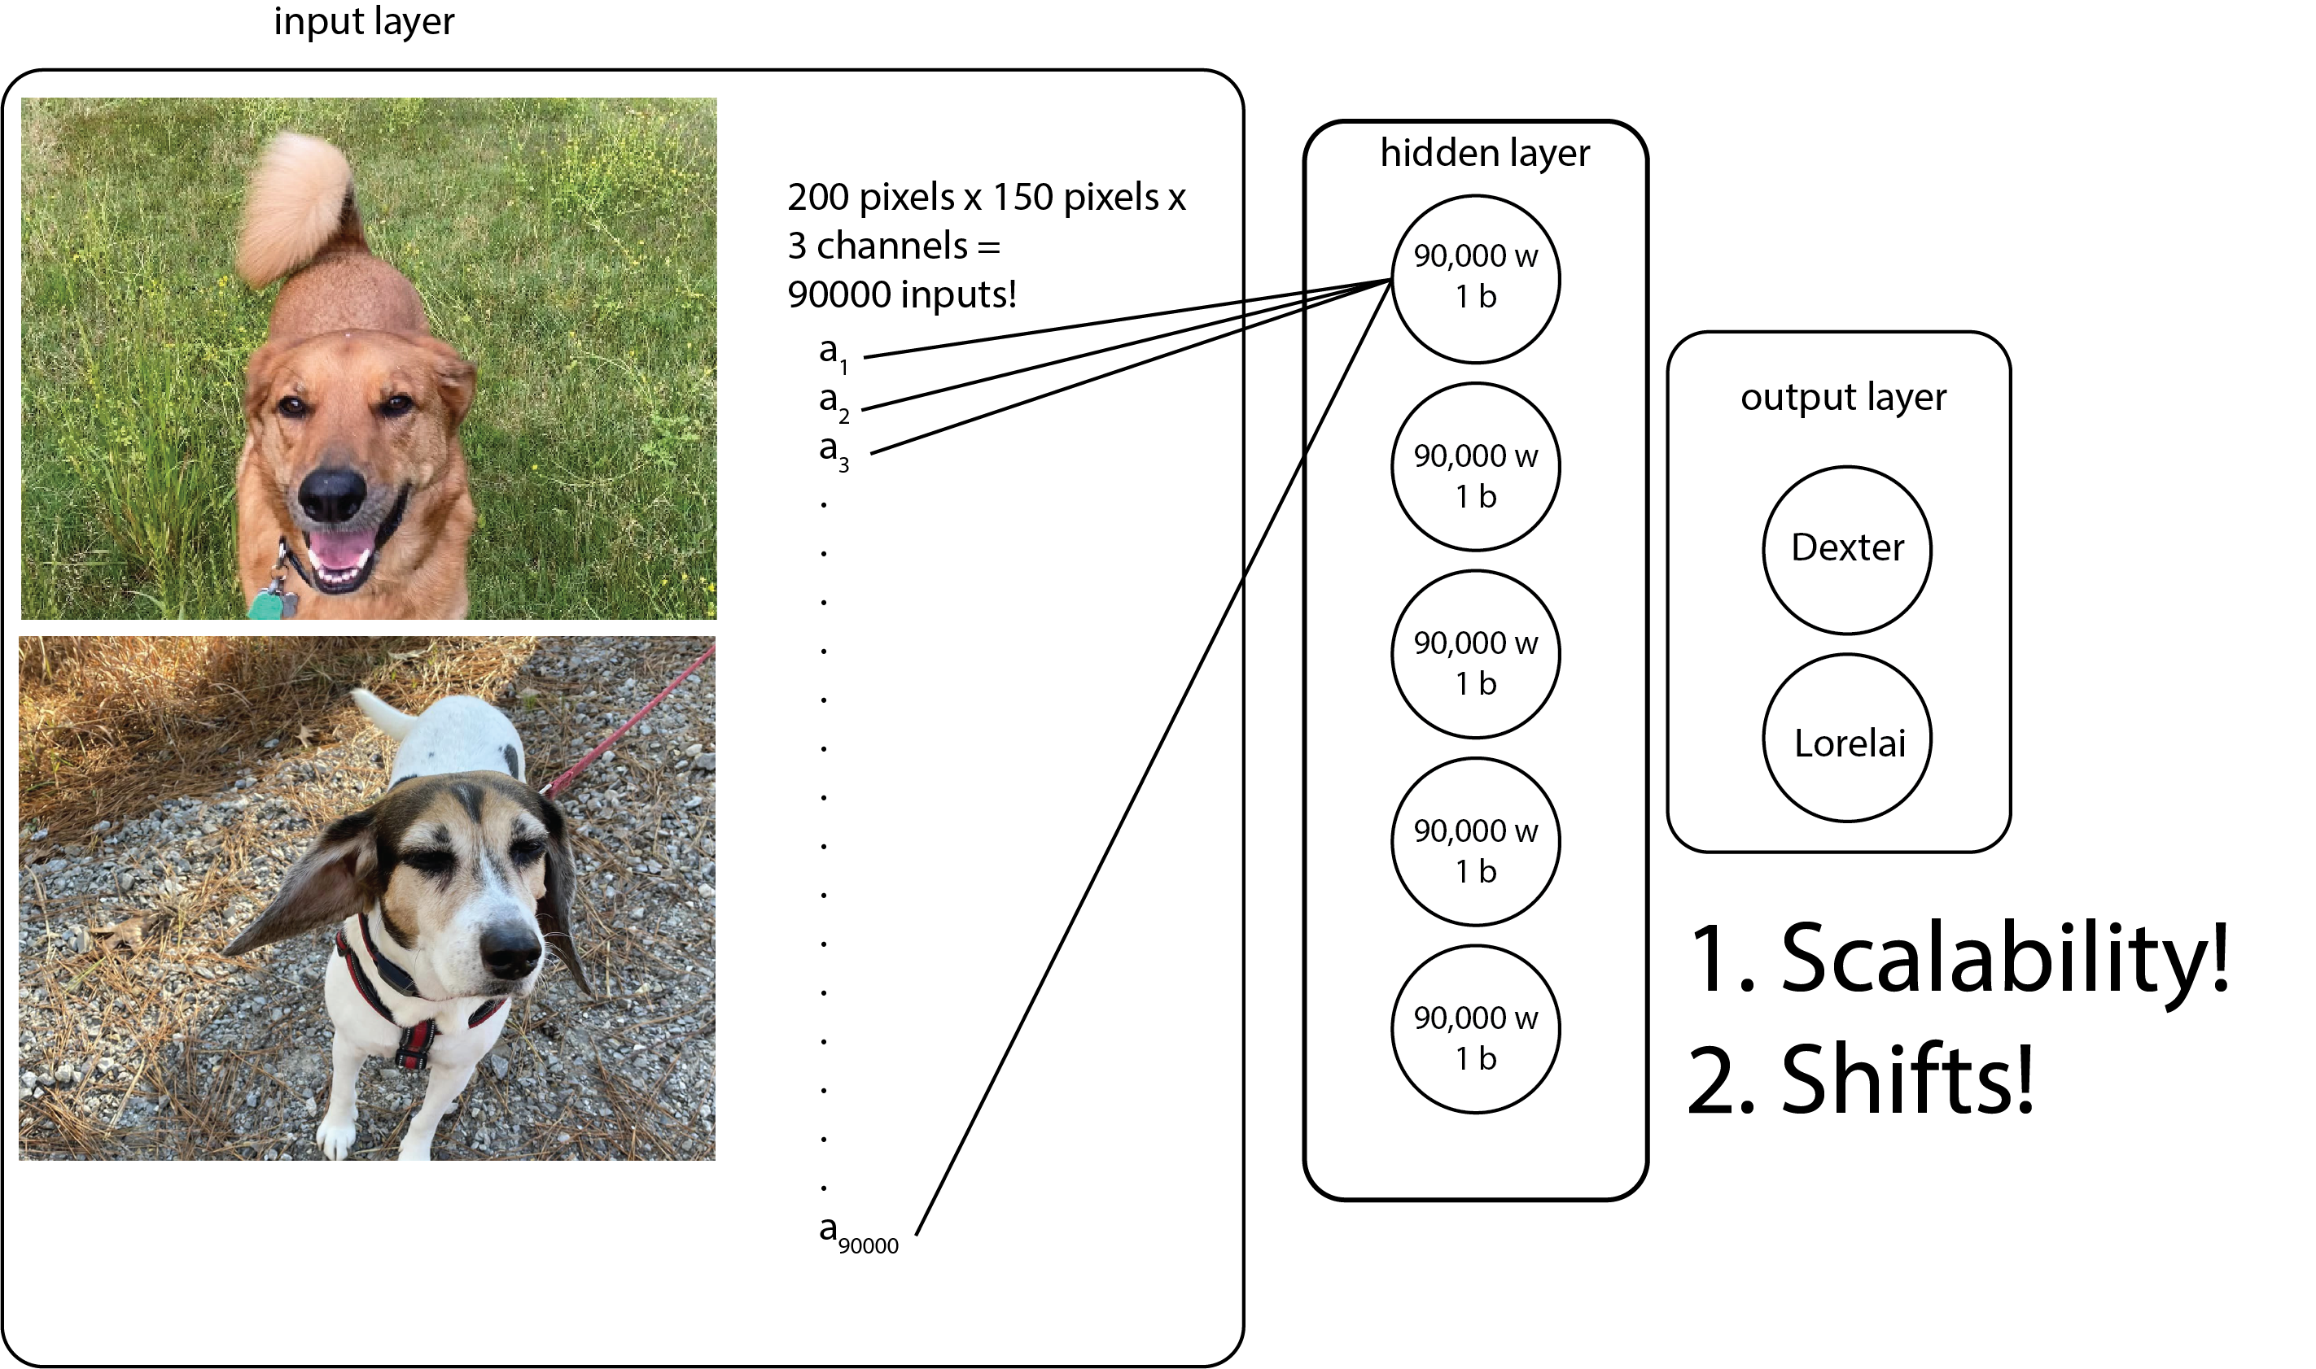
What if I want to classify images?

Slide 6
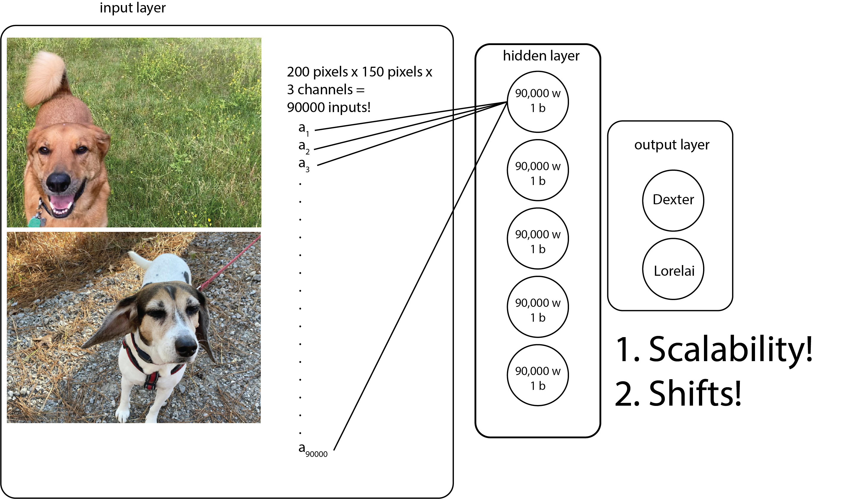
What if I want to classify images?

Slide 7
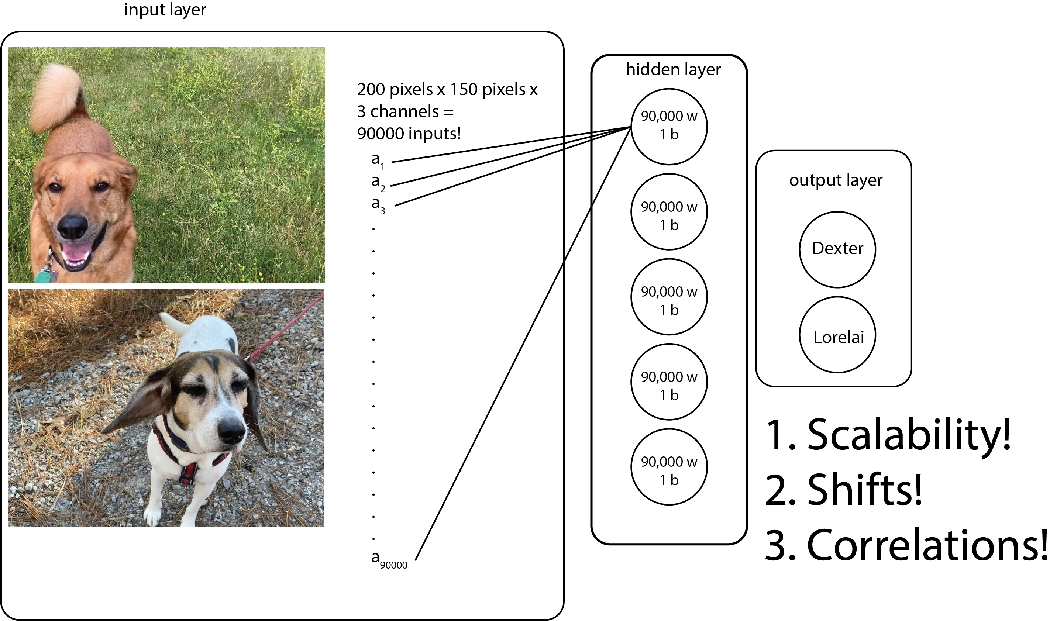
What if I want to classify images?

Slide 8
What if I want to classify images?
Convolutional Neural Networks (CNNs) are designed to perform well on images by improving on fully connected layers in several ways, including:
Scalable
Robust to shifts
Take advantage of correlations between pixels

Slide 9
Outline
Motivation for CNNs
How do CNNs work?
Examples
Population genetics
Phylogenetics
Species Identification
Tumor Detection and Identification

Slide 10
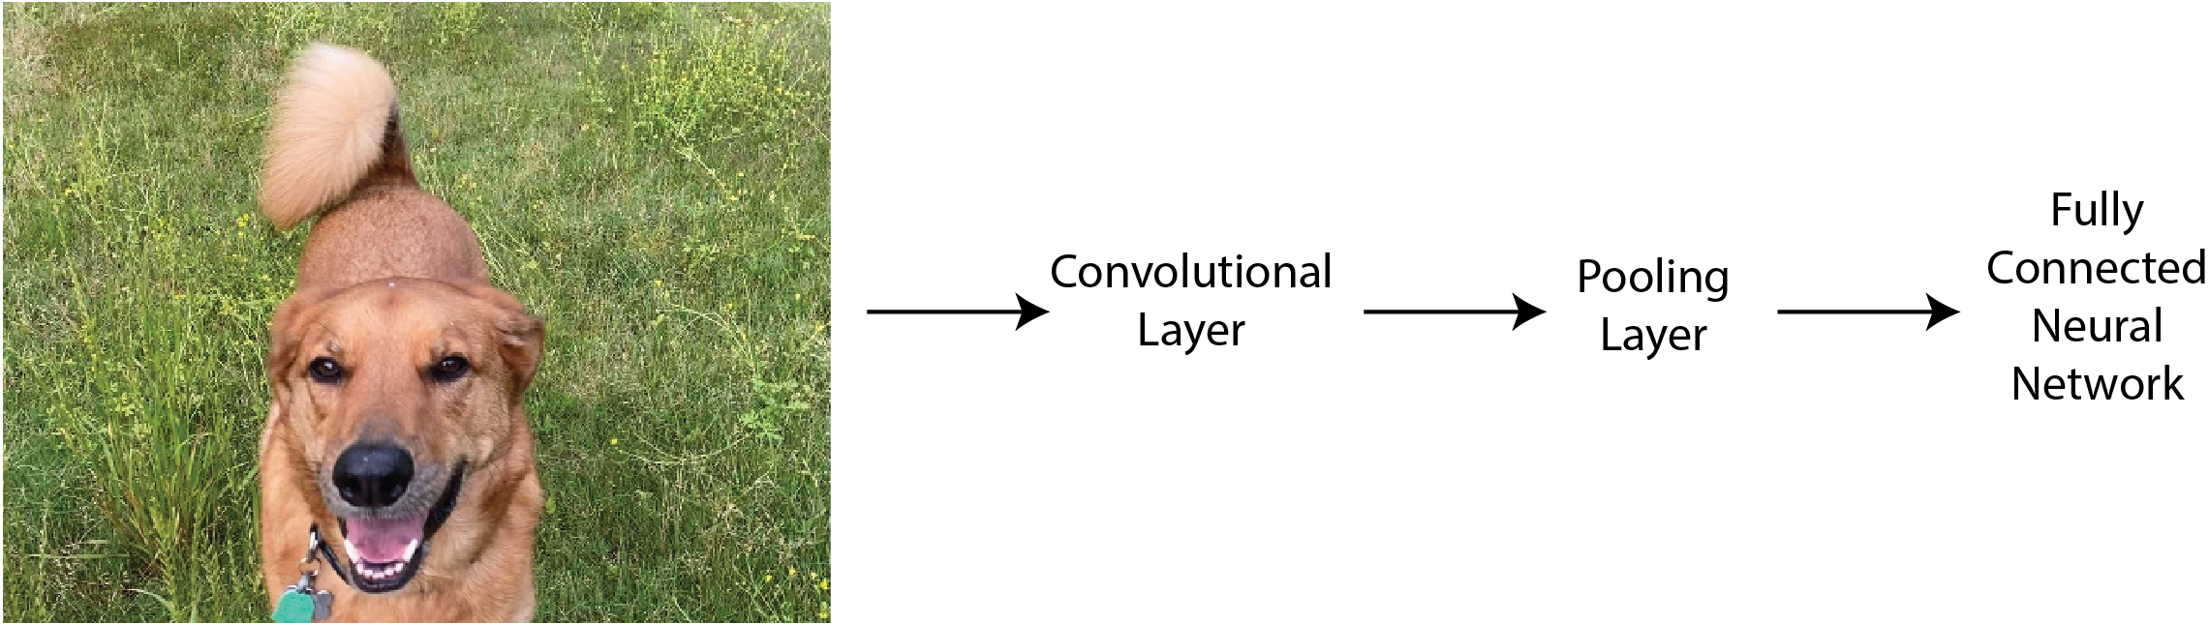
How do CNNs work?

Slide 11
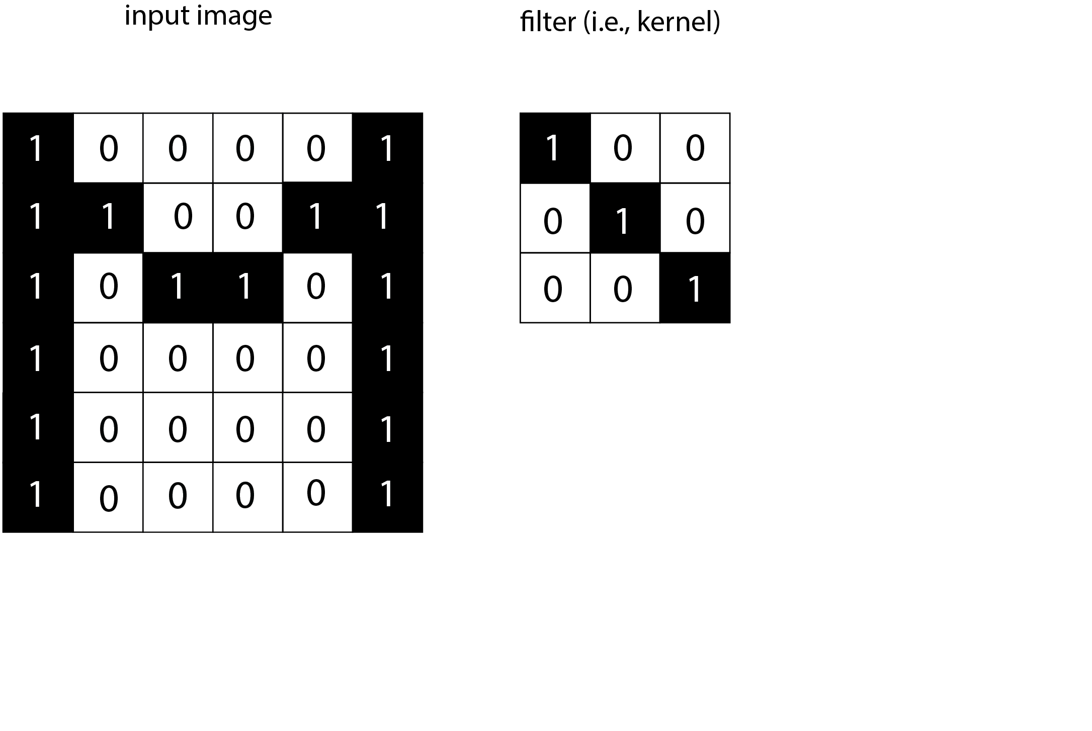
How do CNNs work?

Slide 12
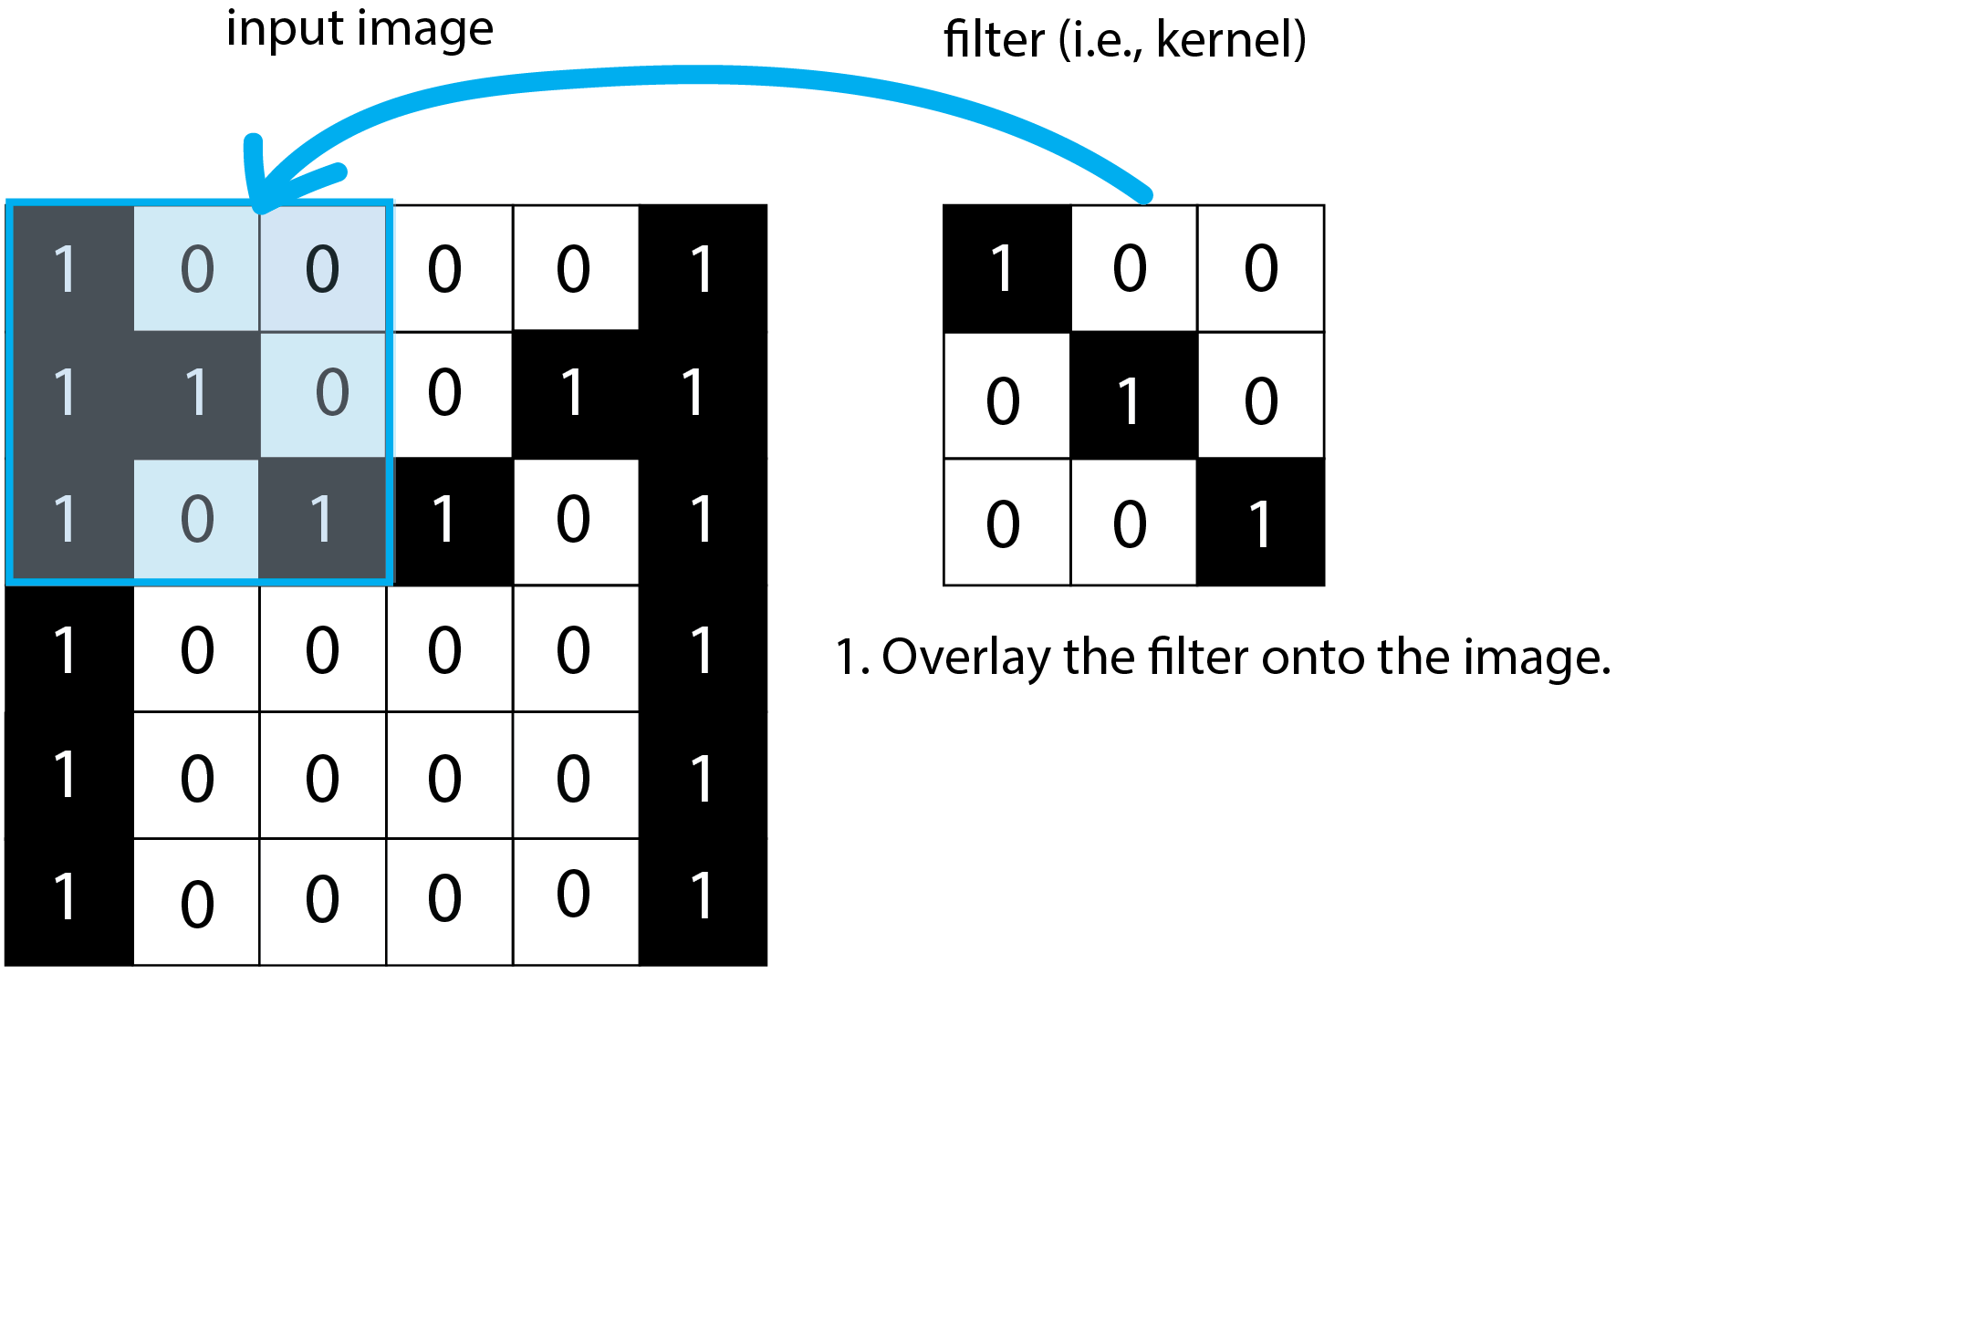
How do CNNs work?

Slide 13
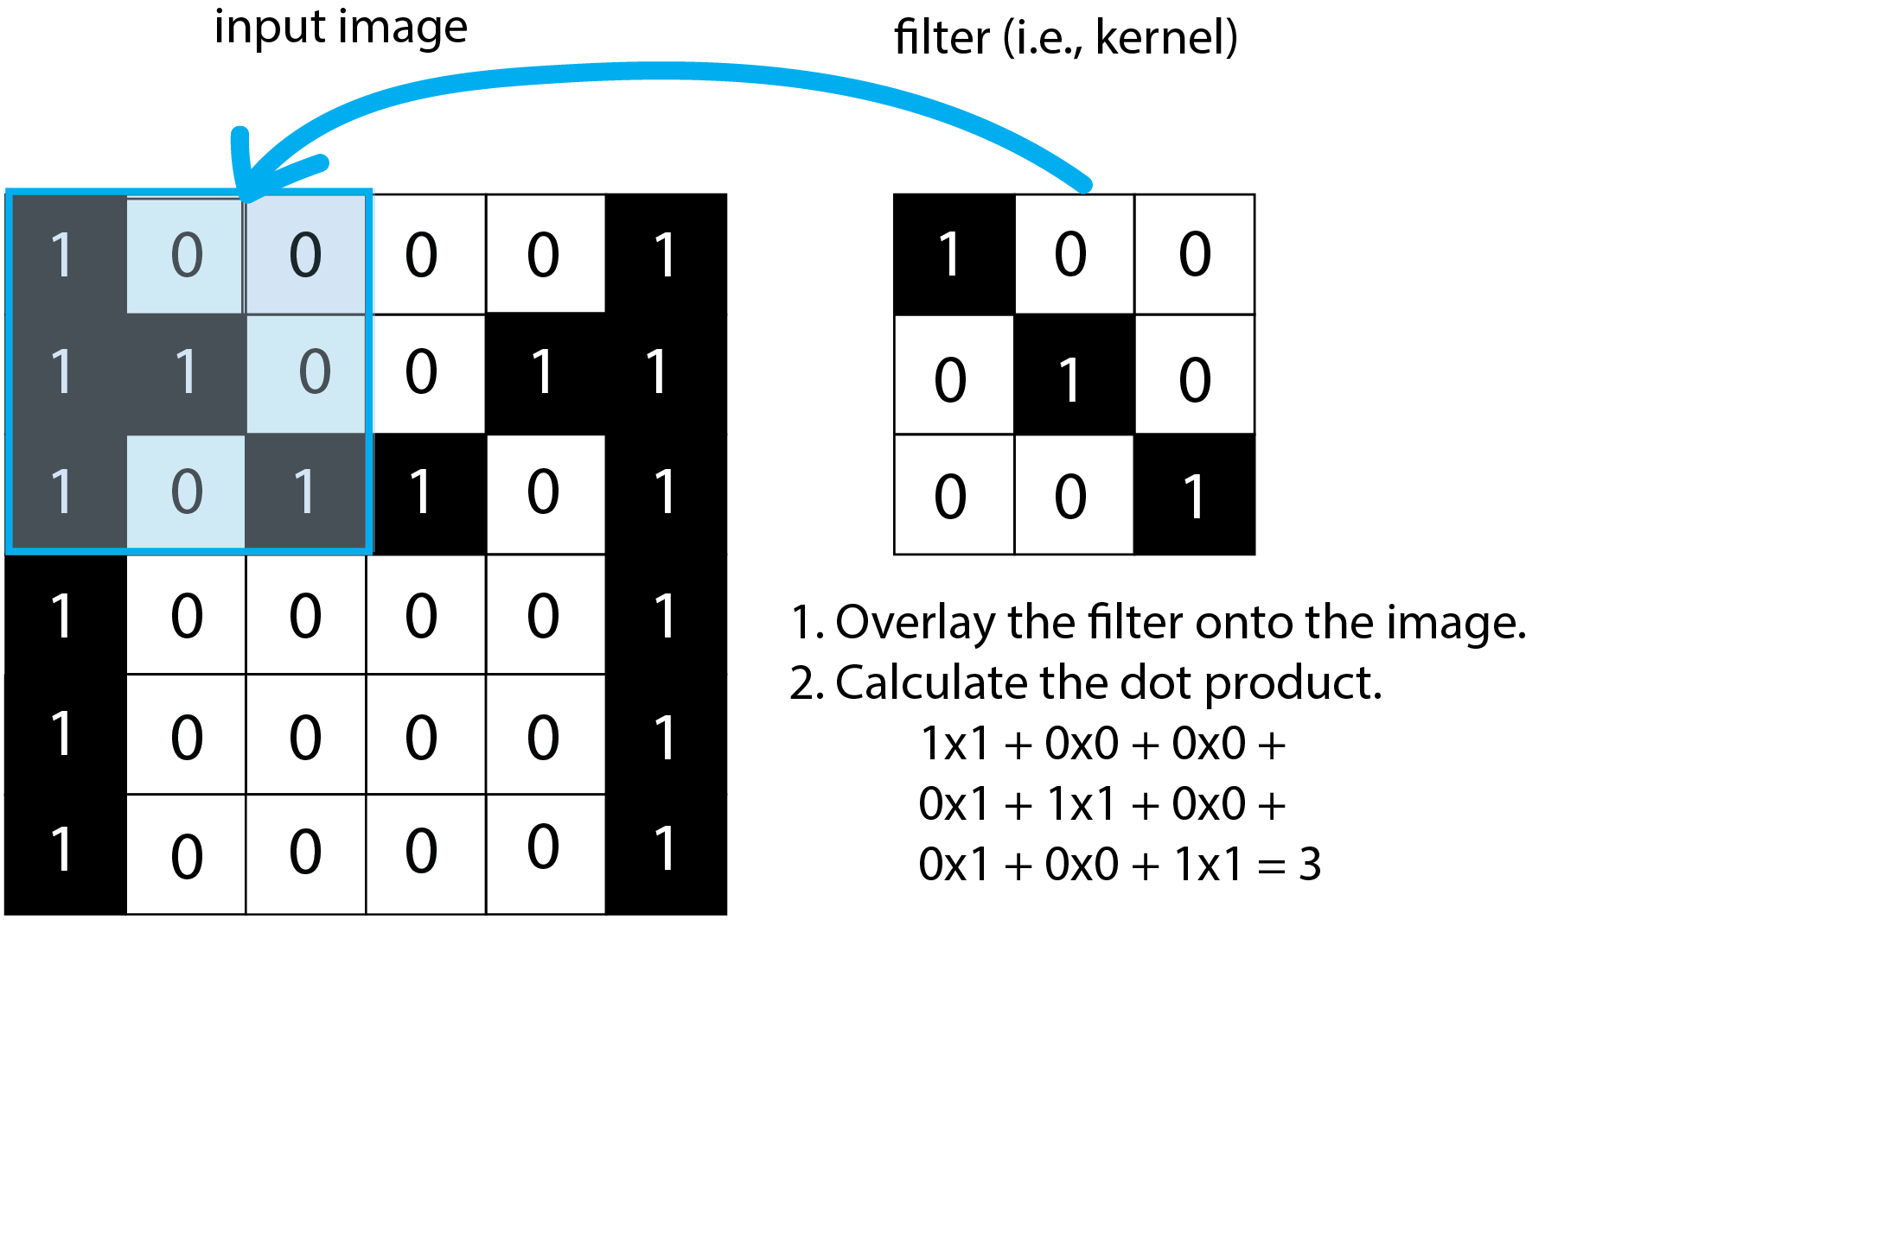
How do CNNs work?

Slide 14

How do CNNs work?

Slide 15
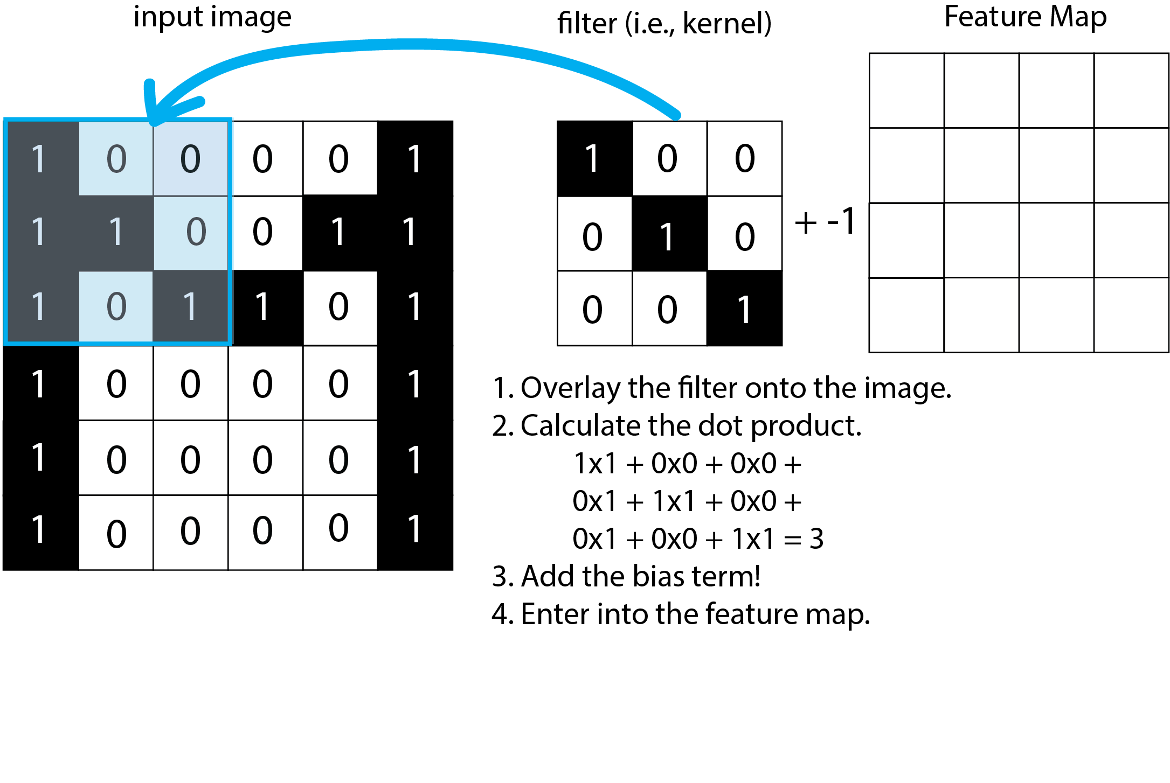
How do CNNs work?

Slide 16

How do CNNs work?

Slide 17
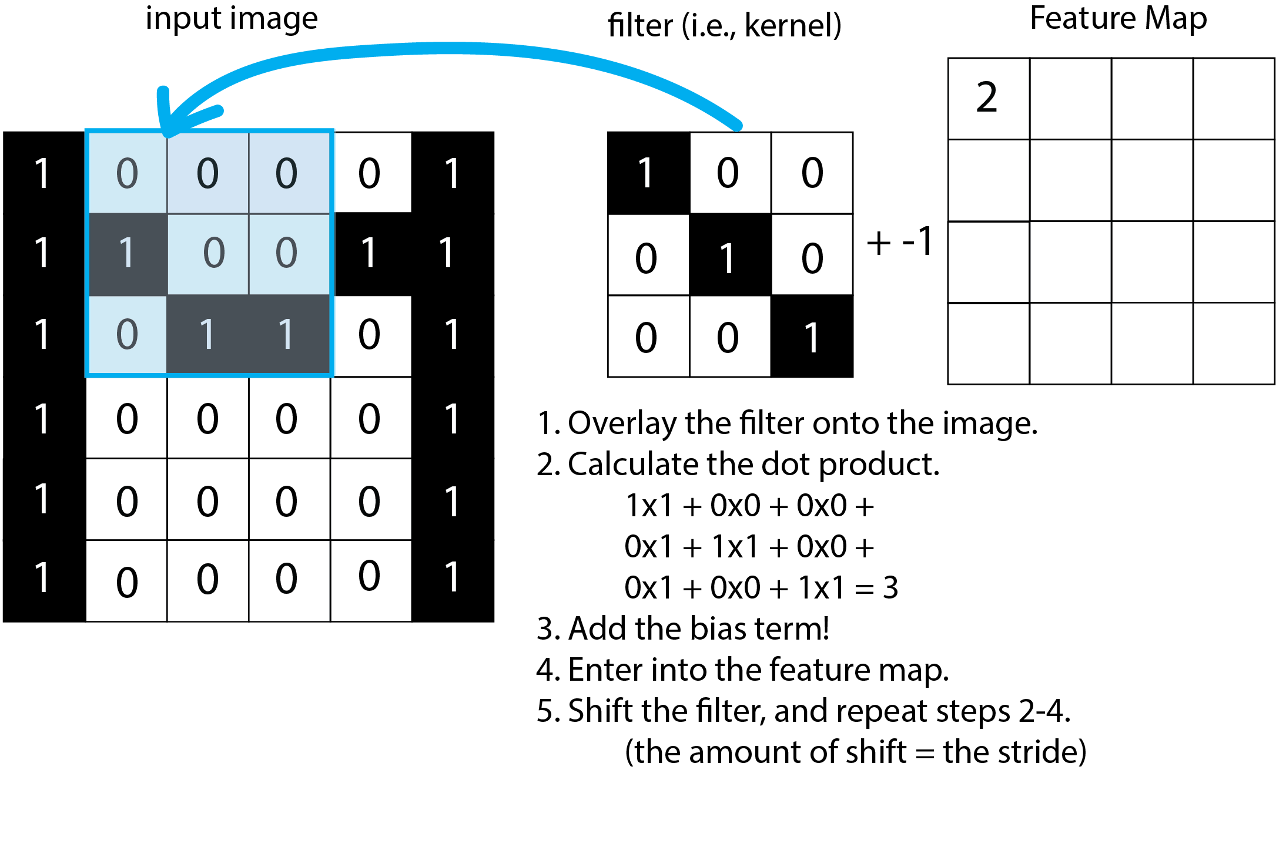
How do CNNs work?

Slide 18
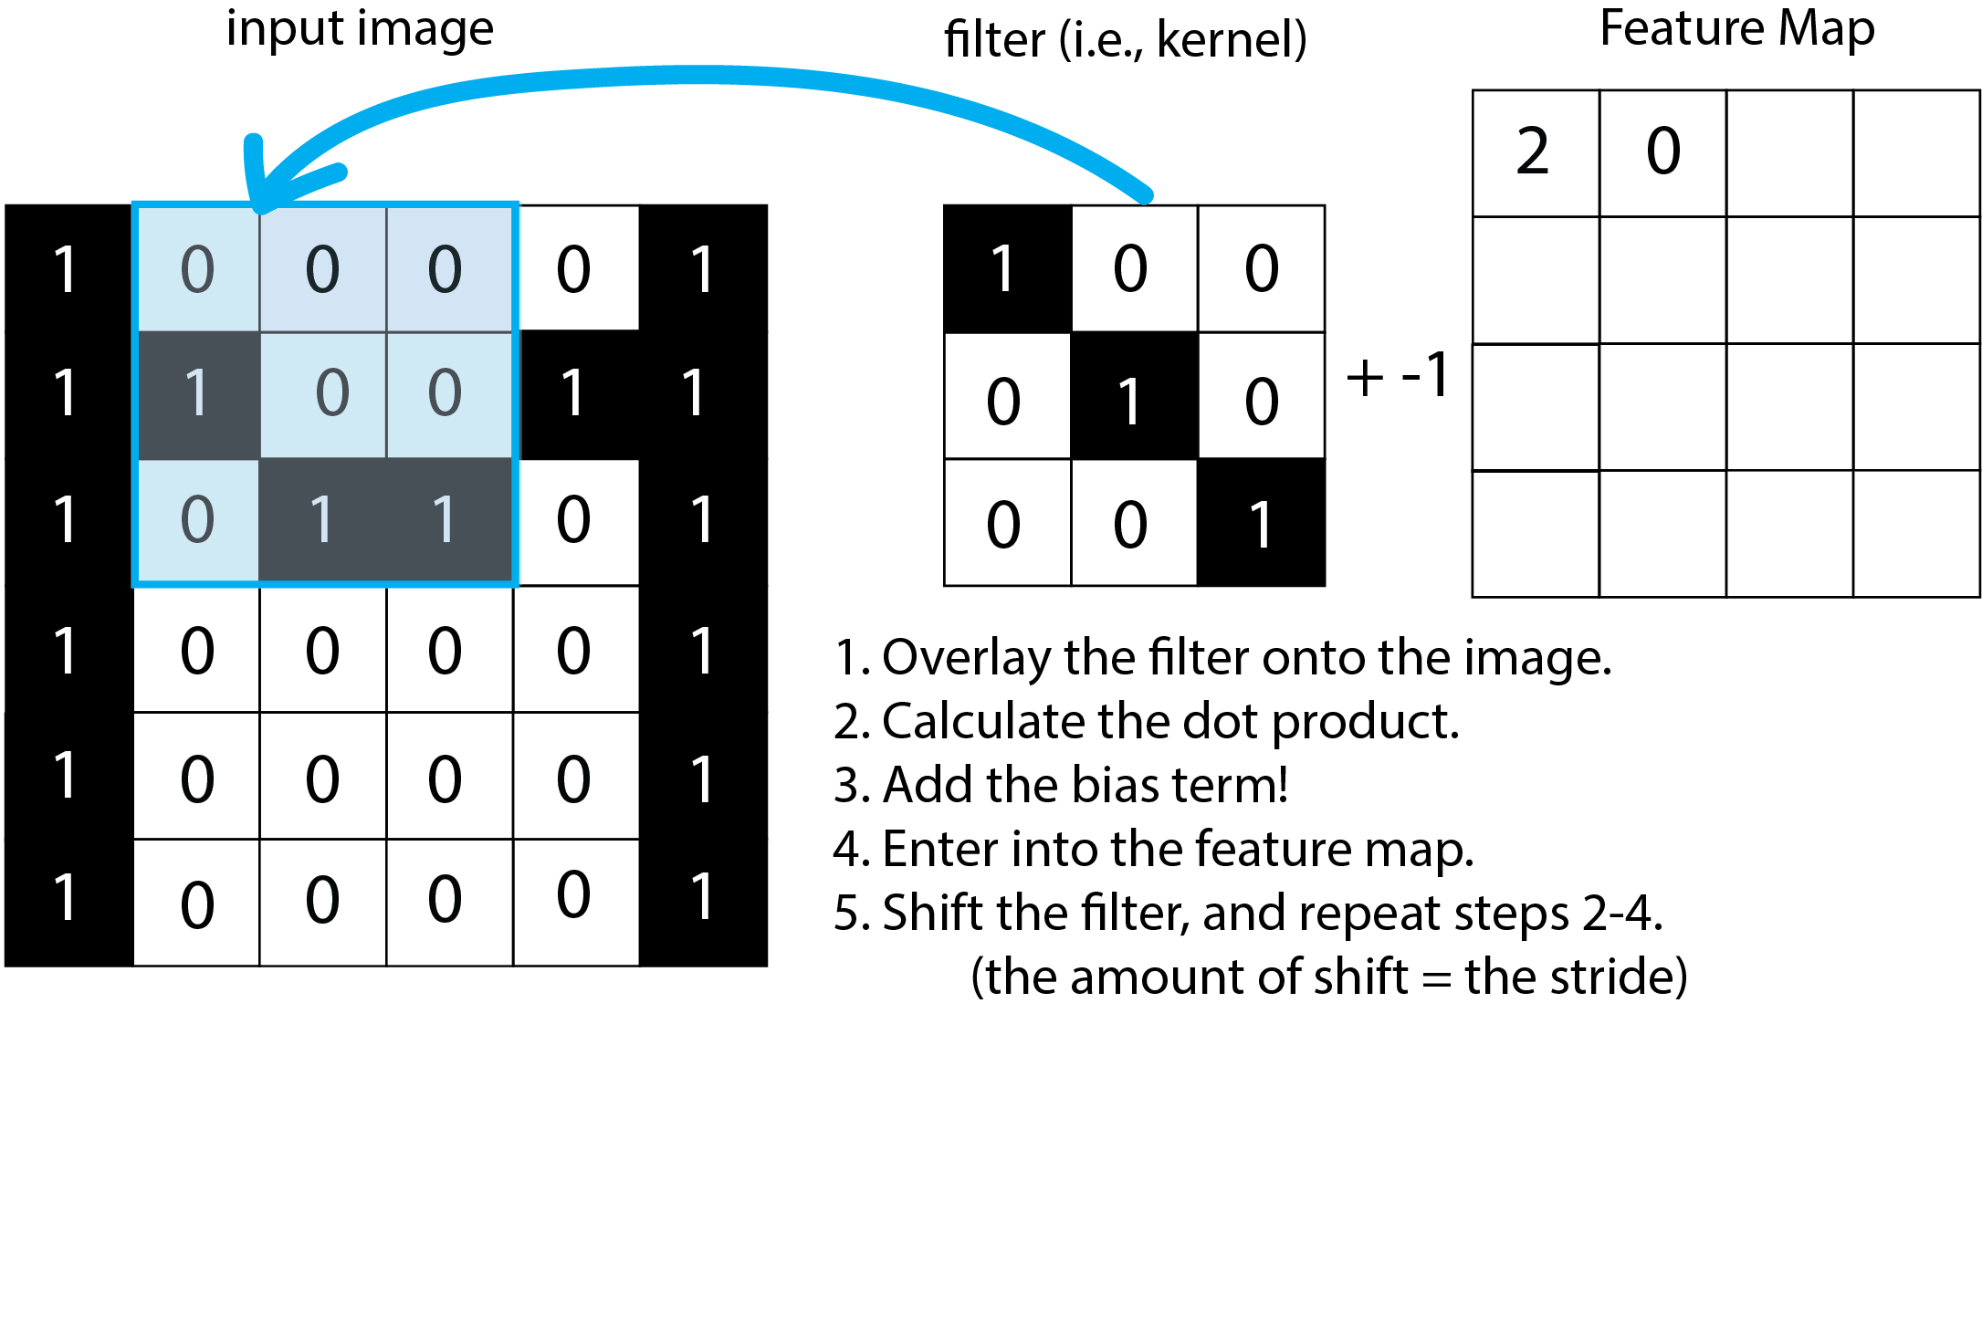
How do CNNs work?

Slide 19
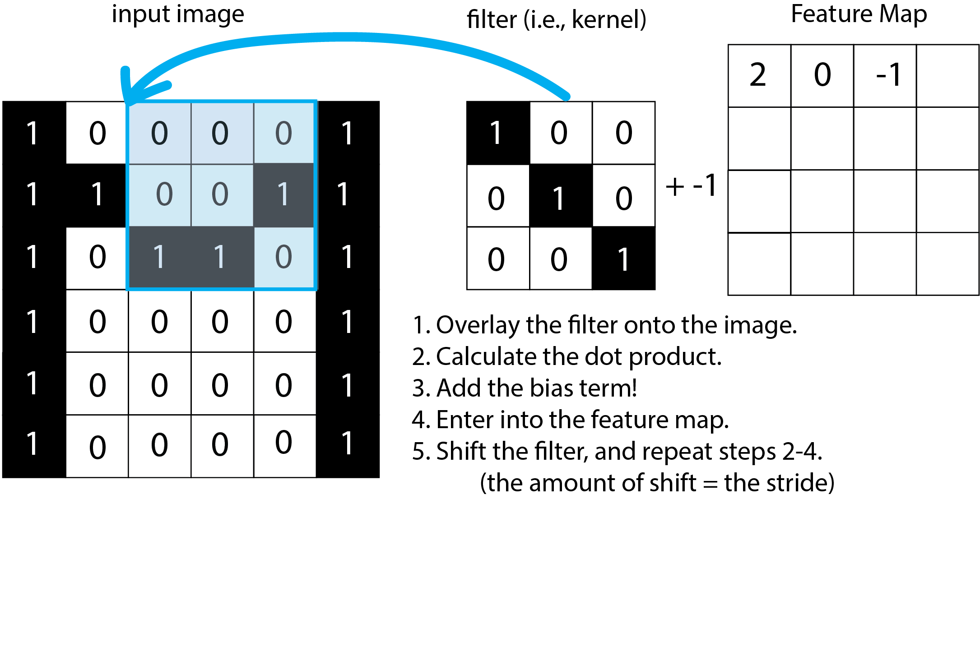
How do CNNs work?

Slide 20
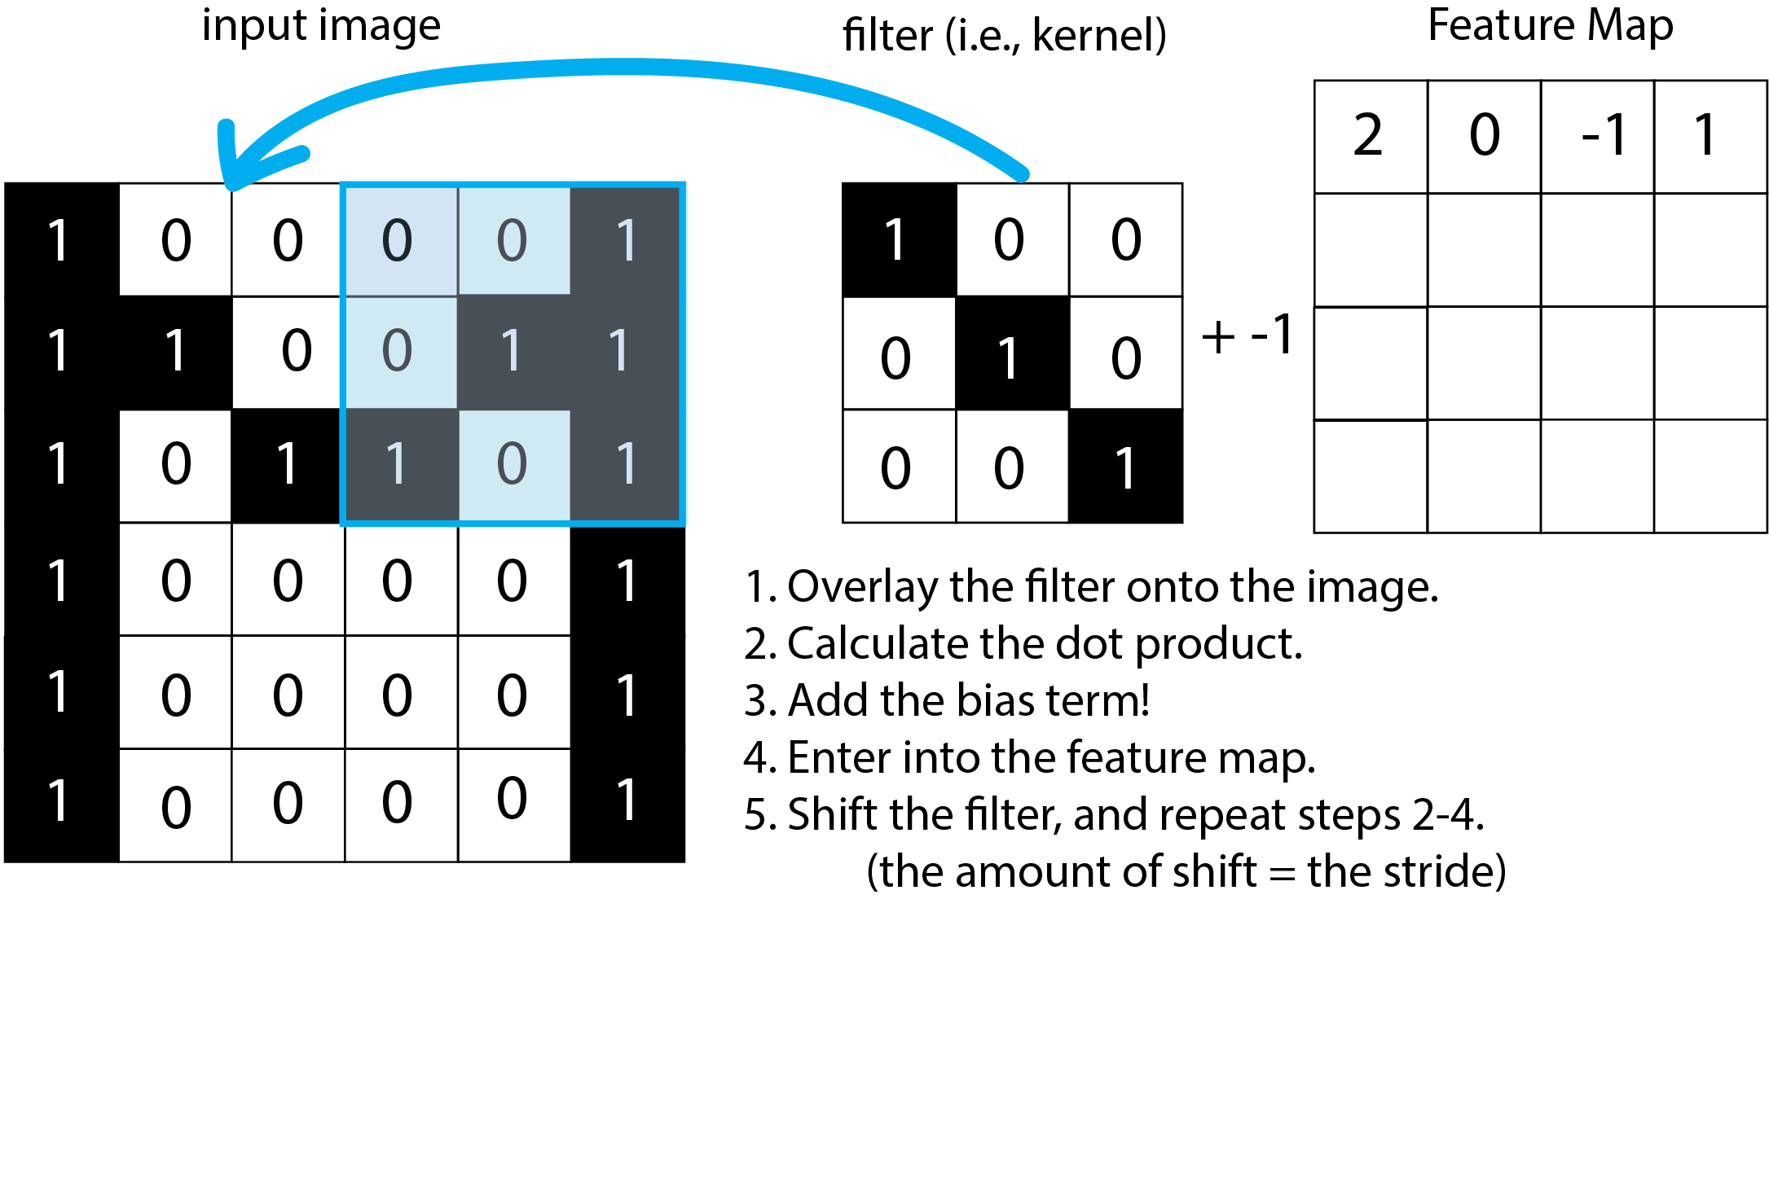
How do CNNs work?

Slide 21
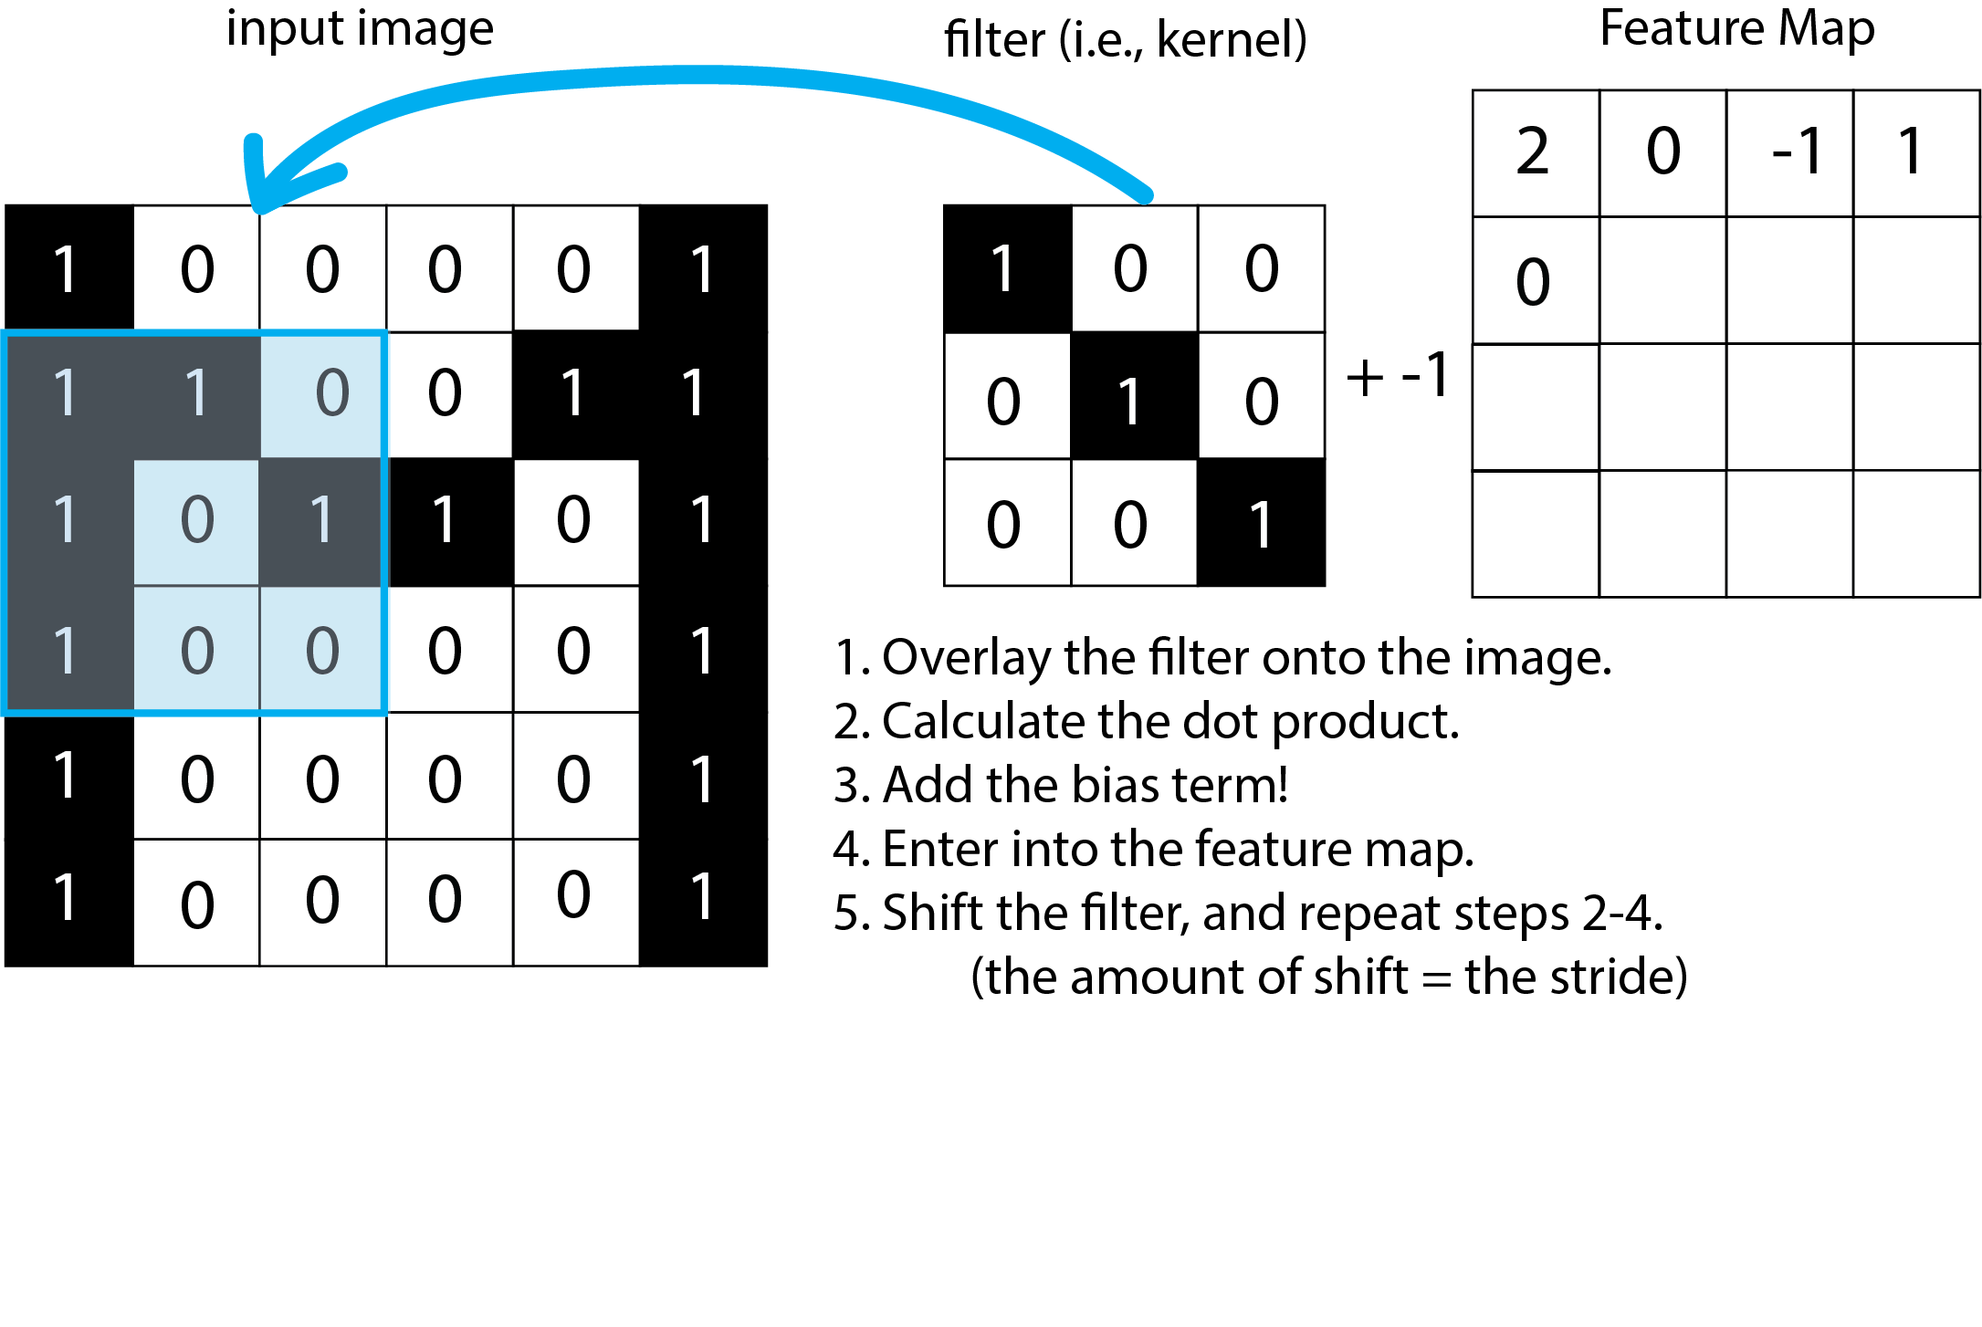
How do CNNs work?

Slide 22
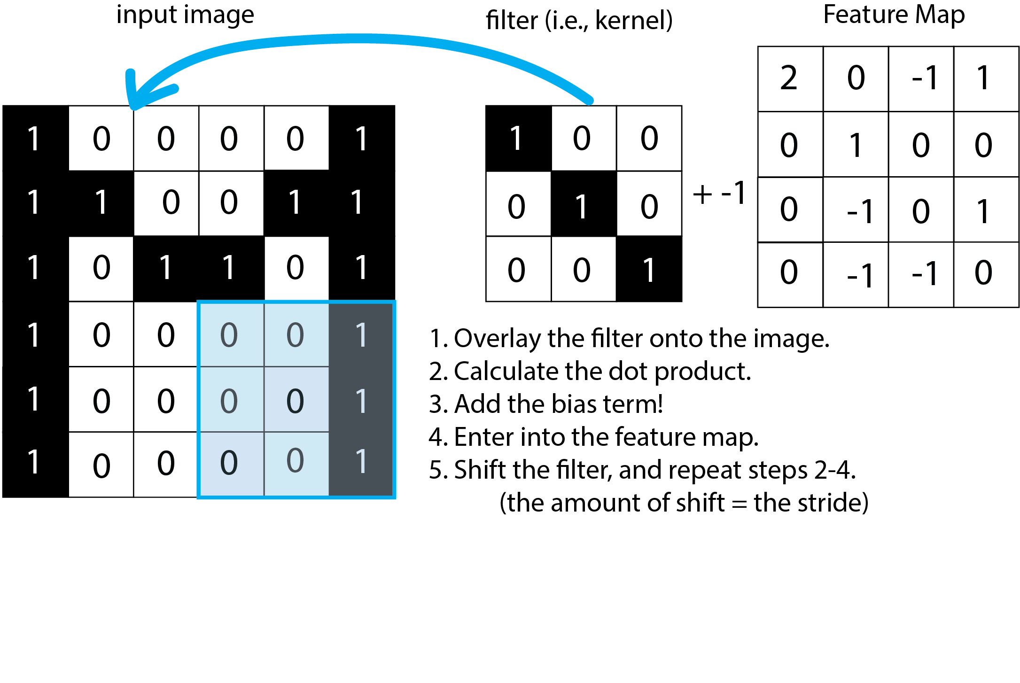
How do CNNs work?

Slide 23
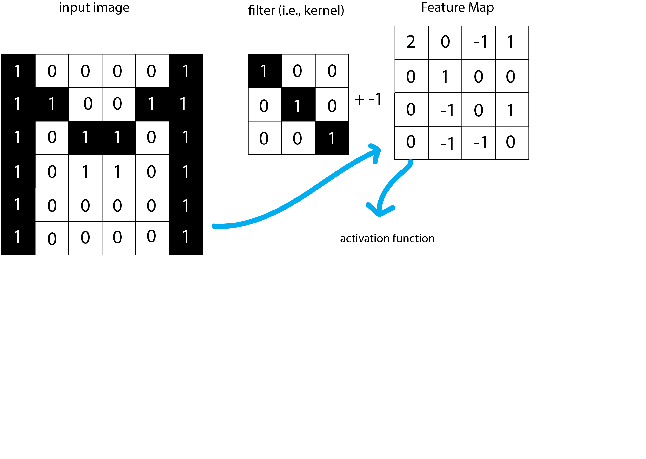
How do CNNs work?

Slide 24
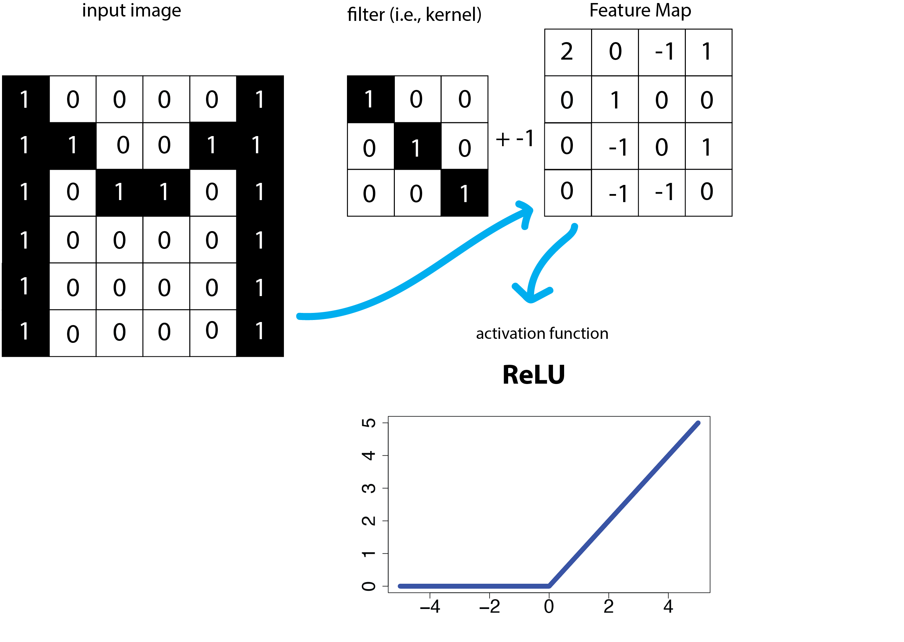
How do CNNs work?

Slide 25
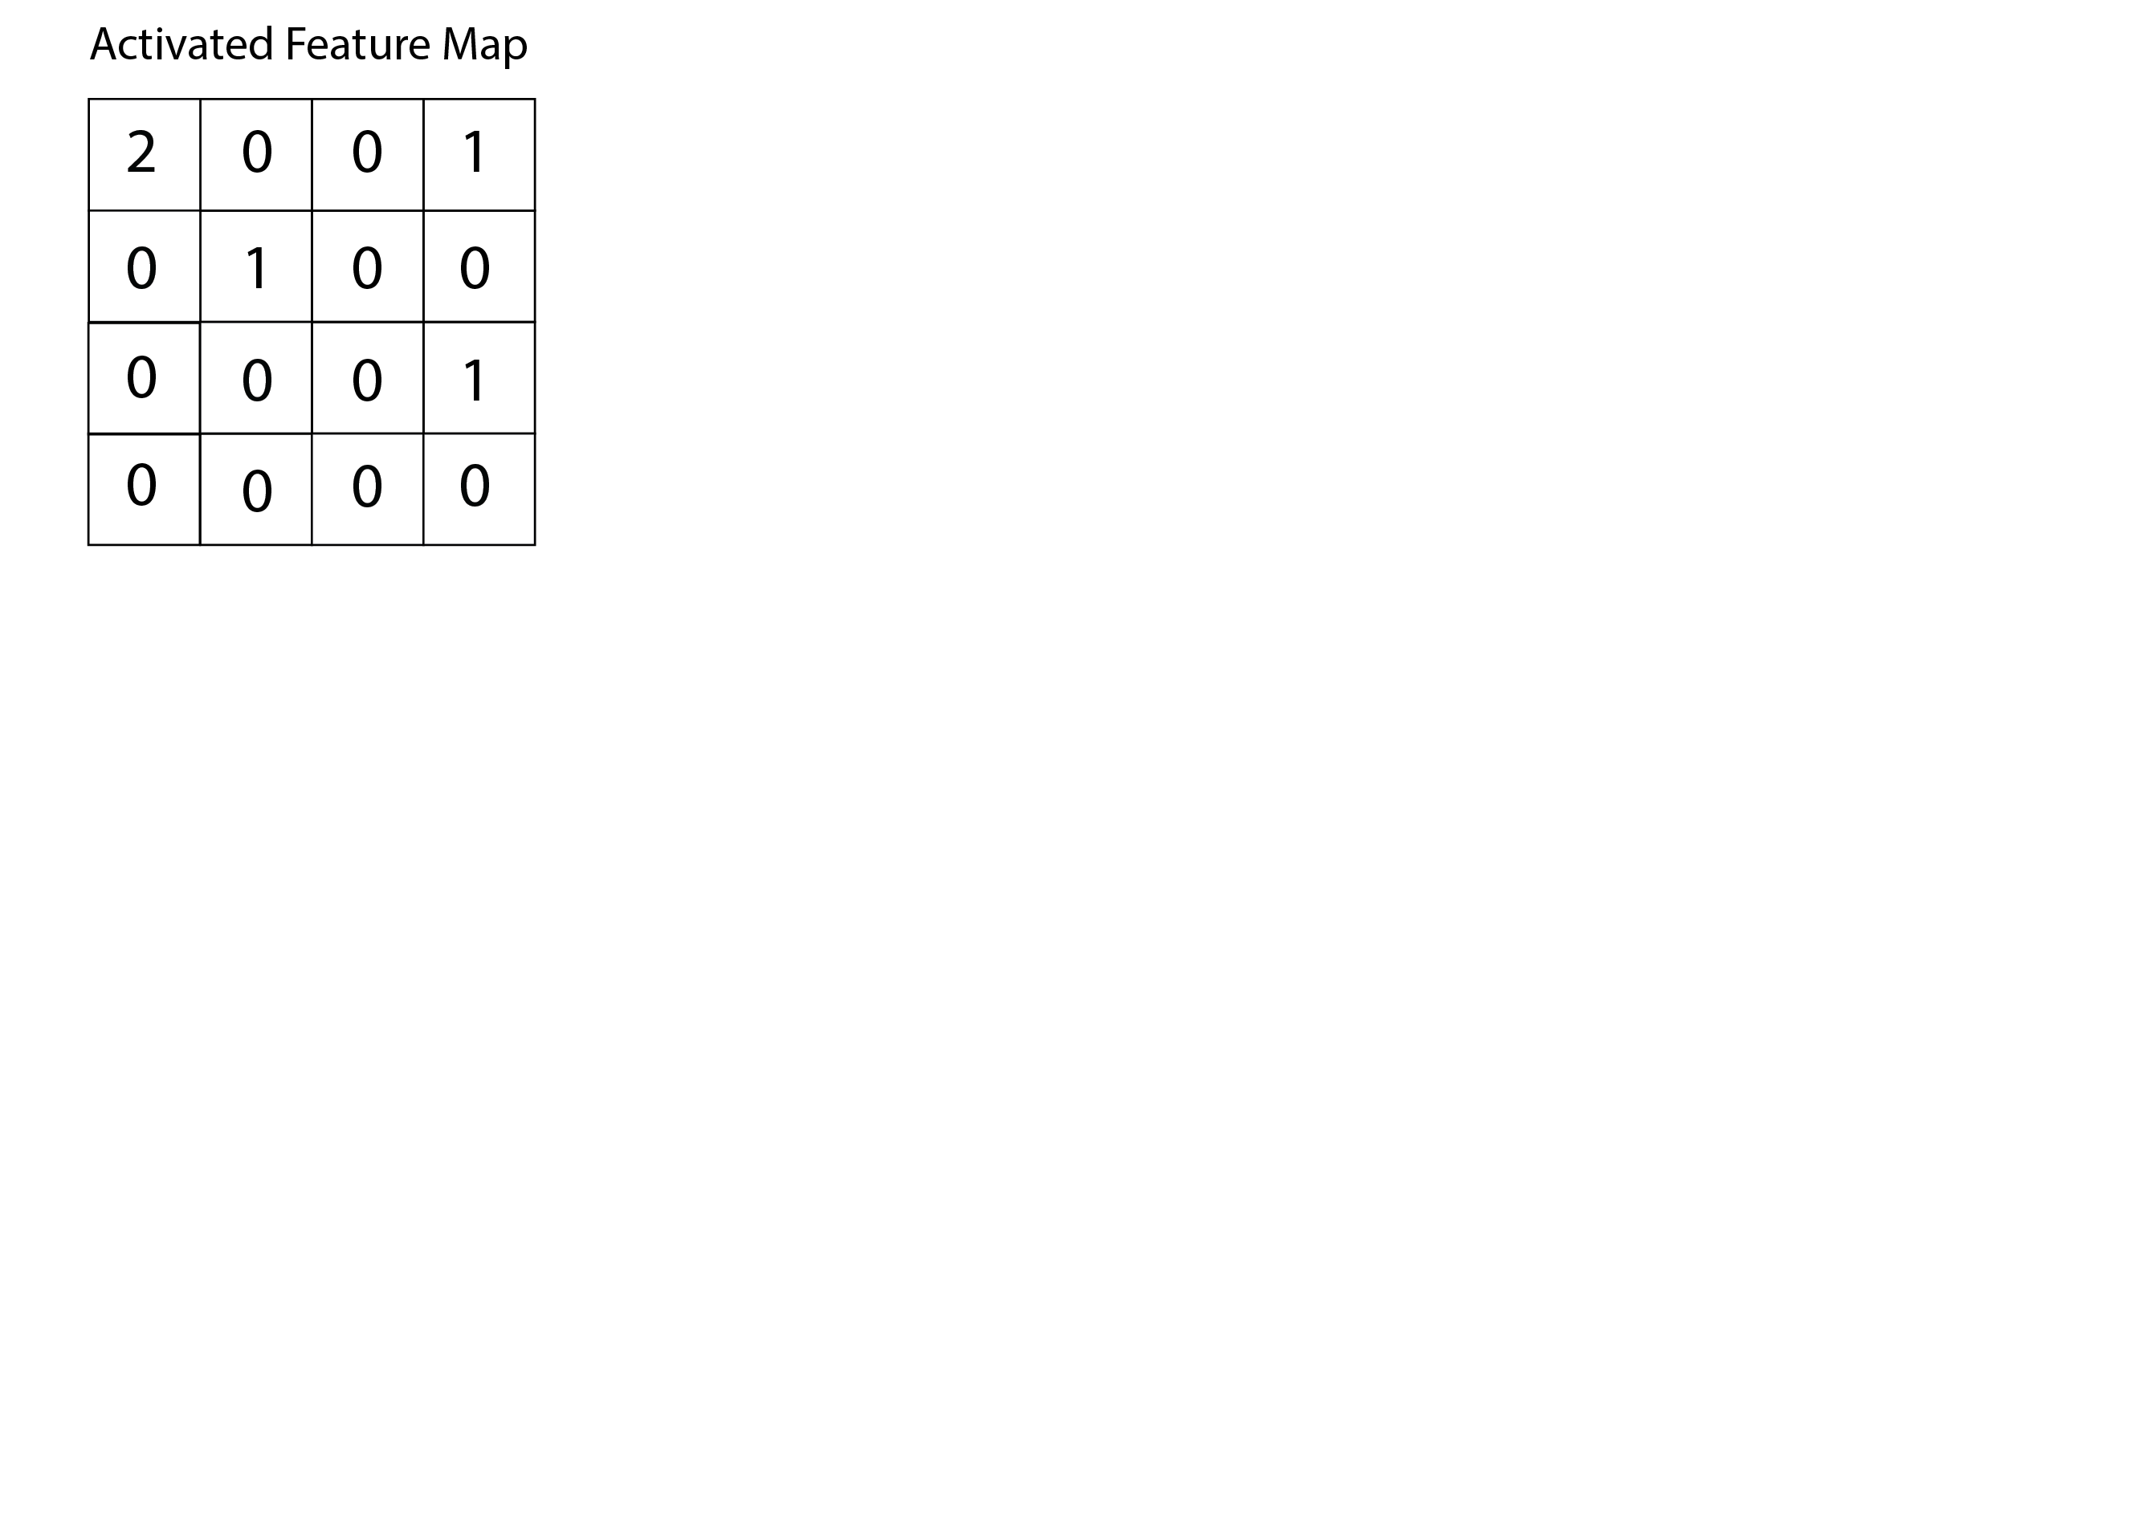
How do CNNs work?

Slide 26
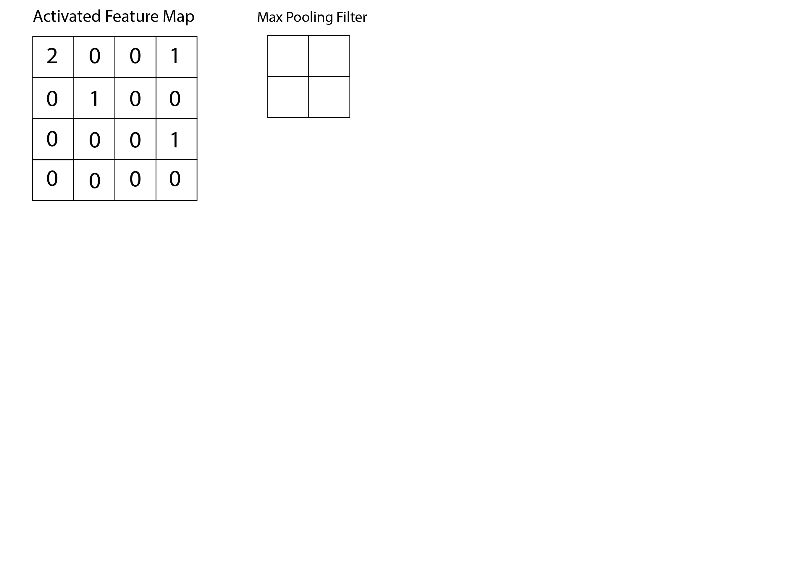
How do CNNs work?

Slide 27
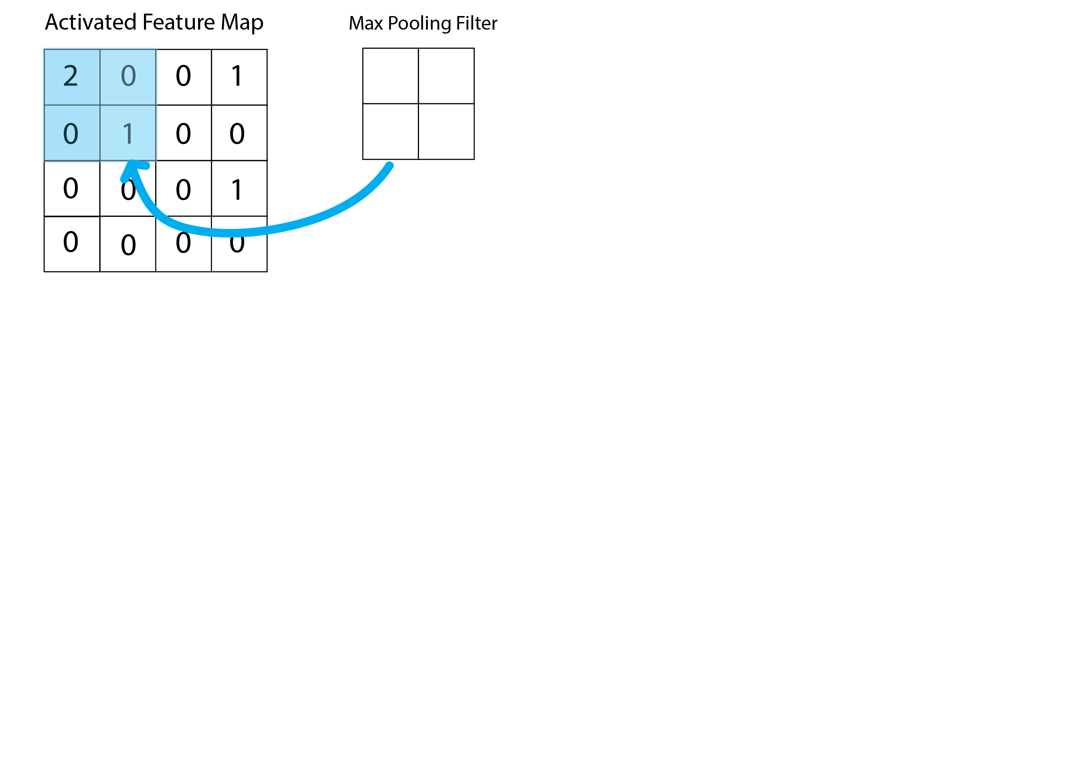
How do CNNs work?

Slide 28
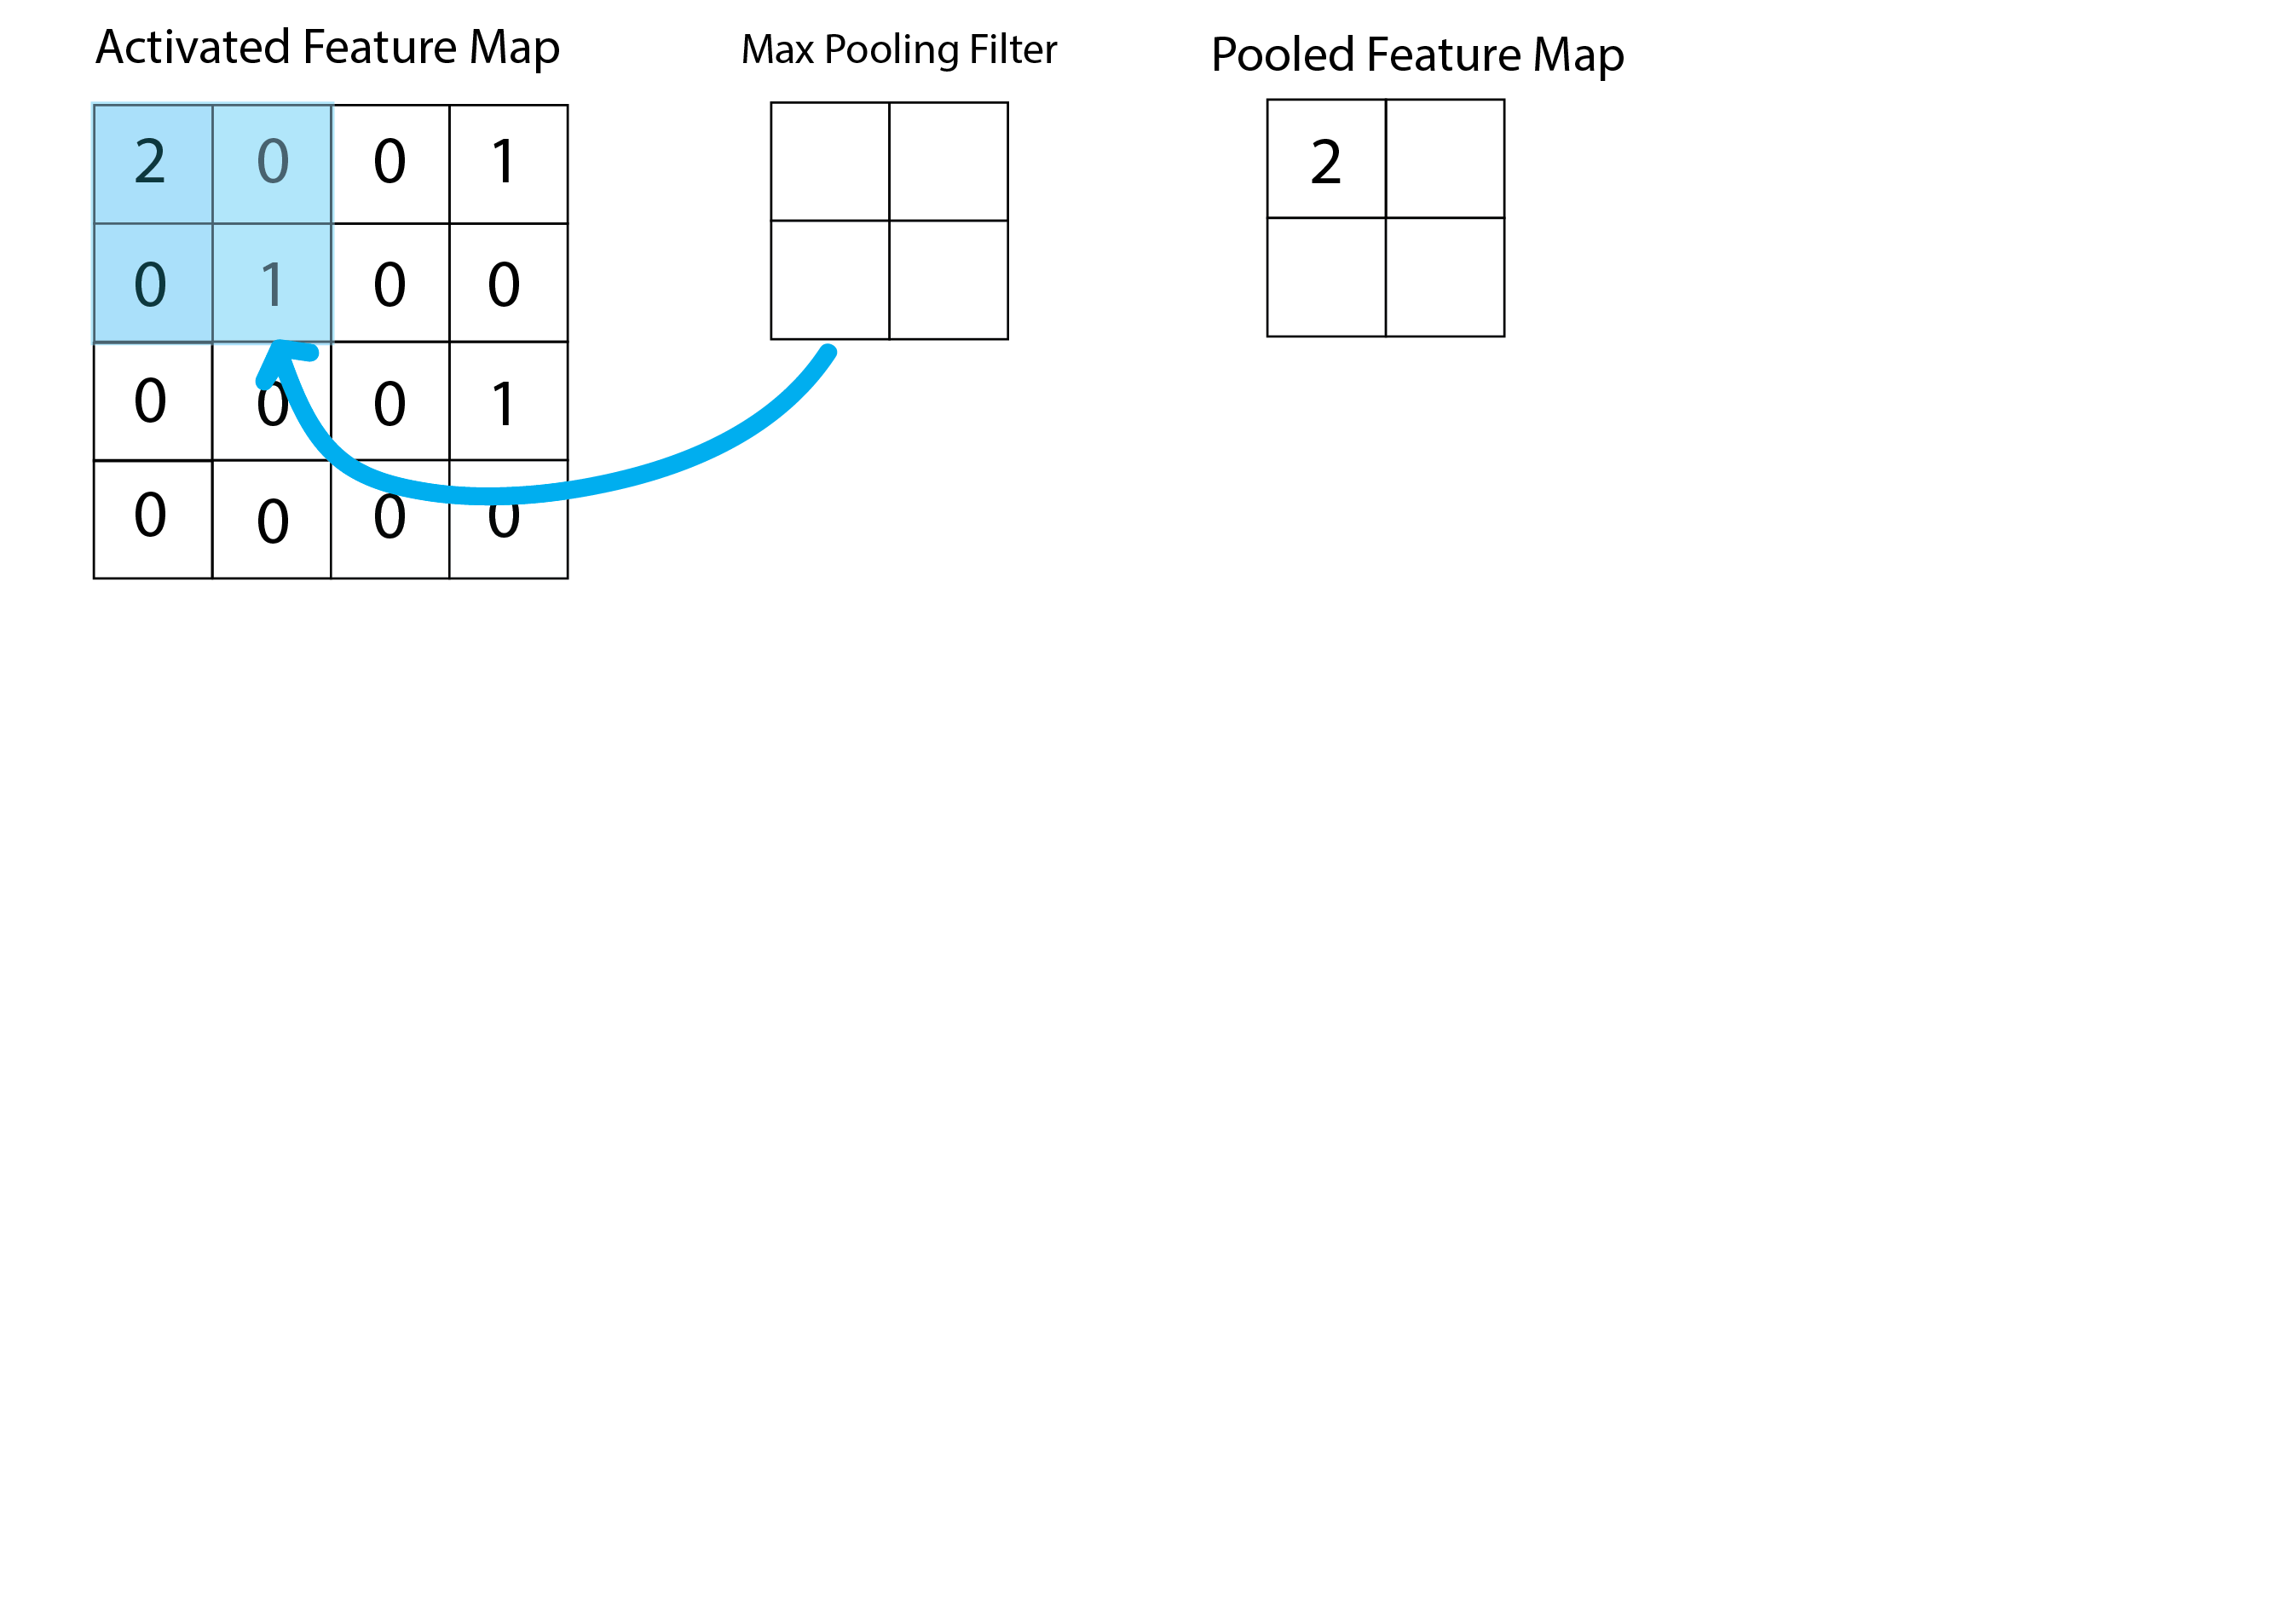
How do CNNs work?

Slide 29
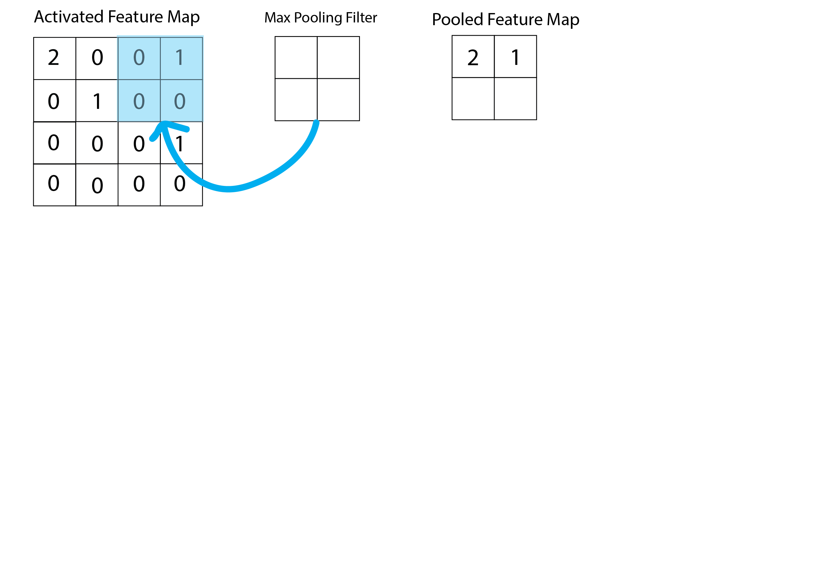
How do CNNs work?

Slide 30
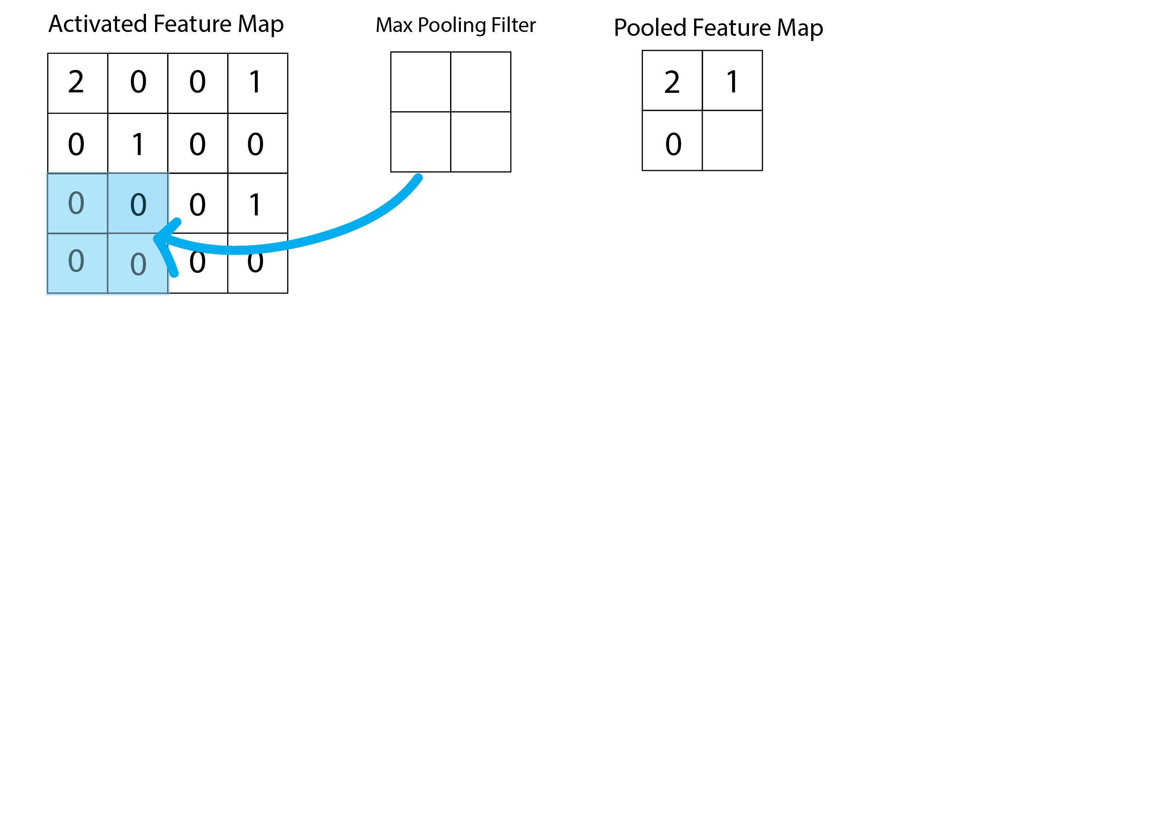
How do CNNs work?

Slide 31
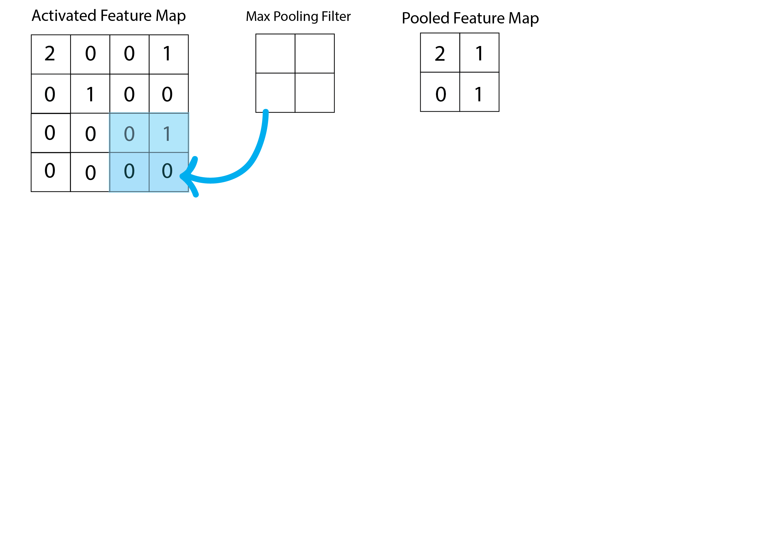
How do CNNs work?

Slide 32
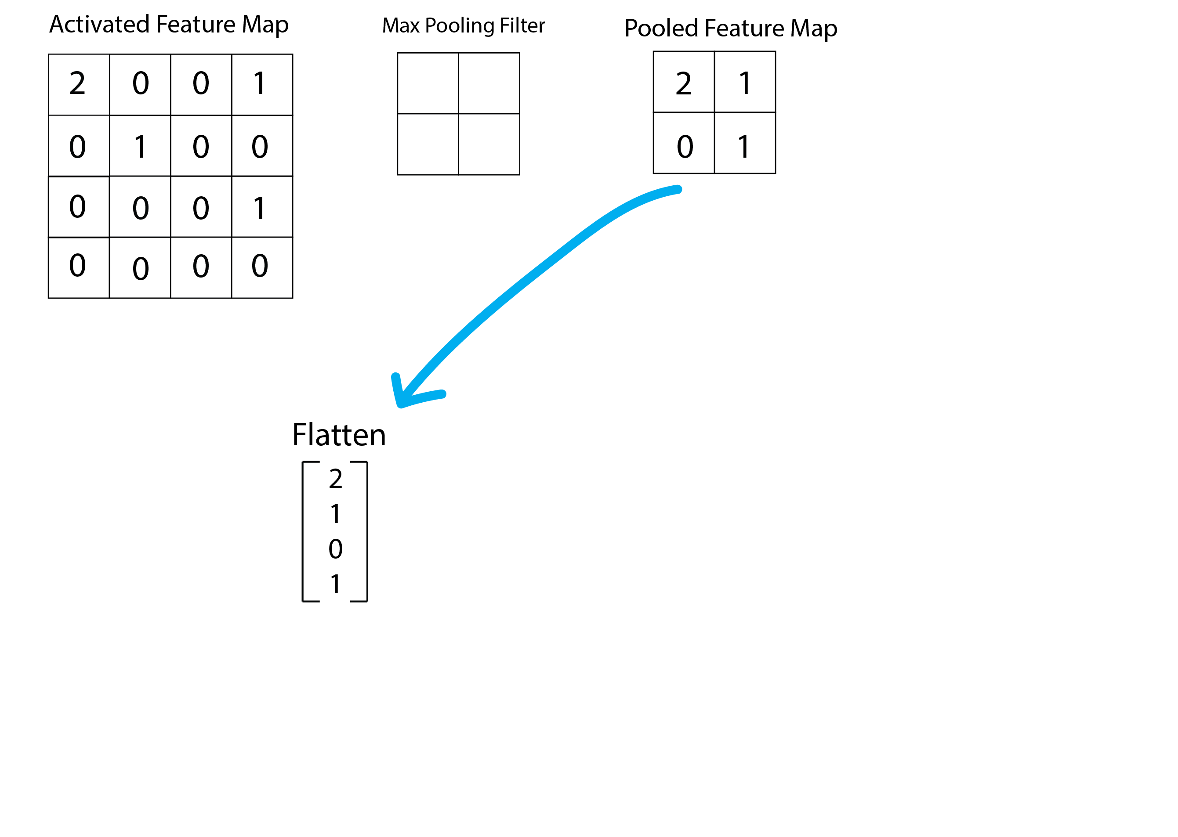
How do CNNs work?

Slide 33
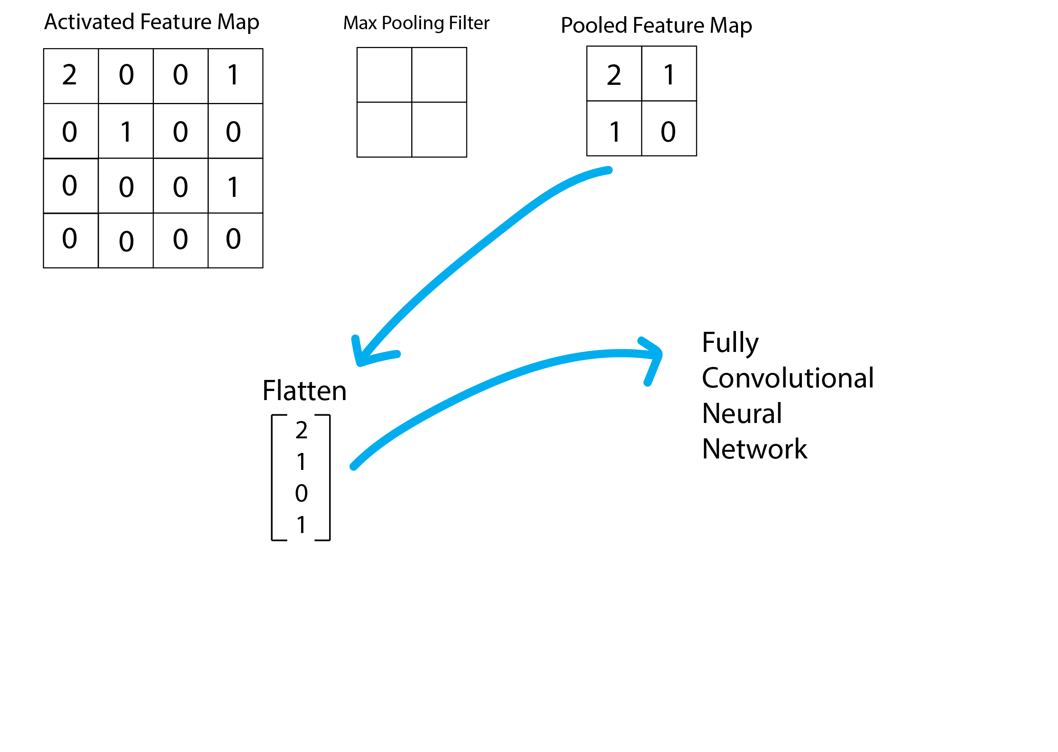
How do CNNs work?

Slide 34
How do CNNs work?
Input: Image
Apply Convolutional Filter (or filters!)
Overlay filter on input image.
Calculate dot product between weights and pixels.
Add bias term.
Populate feature map.
Slide filter, and repeat.
Activate Feature Map.
Perform Pooling.
Flatten into vector.
Feed into fully connected neural network.

Slide 35
How do CNNs work?
learnable parameters: weights (for each cell of each convolutional filter) and biases (one per filter)
Hyperparameters: the number of convolutional layers, the activation functions, the number of filters, the size of the filters, the stride size, the type of pooling, the FCNN hyperparameters!

Slide 36
Outline
Motivation for CNNs
How do CNNs work?
Examples
Population genetics
Phylogenetics
Species Identification
Tumor Detection and Identification

Slide 37
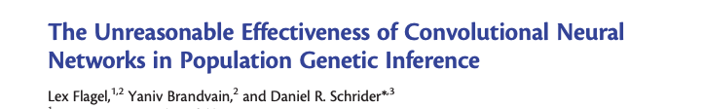
How do we use CNNs in population genetics?
We can treat alignments as images!
This allows us to avoid a priori summarization of our data using features.
Instead, our network learns the features directly.

Slide 38
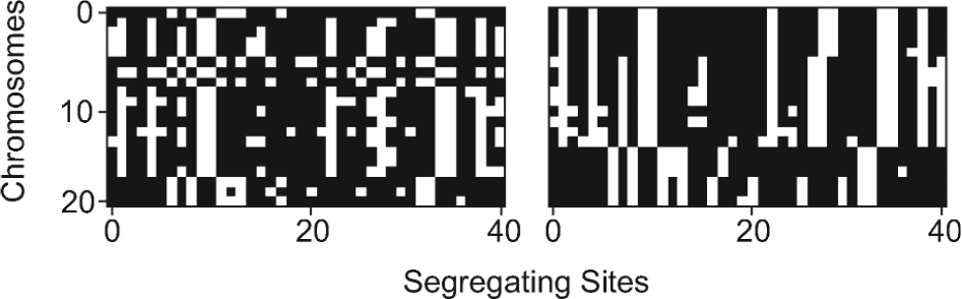
How do we use CNNs in population genetics?
Figure 2 from Flagel et al., 2019

Slide 39
How do we use CNNs in population genetics?
Challenges (because alignments aren’t images!)
Images input into a CNN generally need to be of the same size, but in reality different datasets have different numbers of sites and different numbers of individuals.
The order of rows in an alignment shouldn’t matter, but CNNs are not invariant to permutations of rows.

Slide 40
How do we use CNNs in population genetics?
Challenges (because alignments aren’t images!)
Images input into a CNN generally need to be of the same size, but in reality different datasets have different numbers of sites and different numbers of individuals.
Solution (Flagel): padding with zeros
Solution (later): create special network architectures
The order of rows in an alignment shouldn’t matter, but CNNs are not invariant to permutations of rows.
Solution (Flagel): sort by similarity
Solution (later): create special network architectures

Slide 41
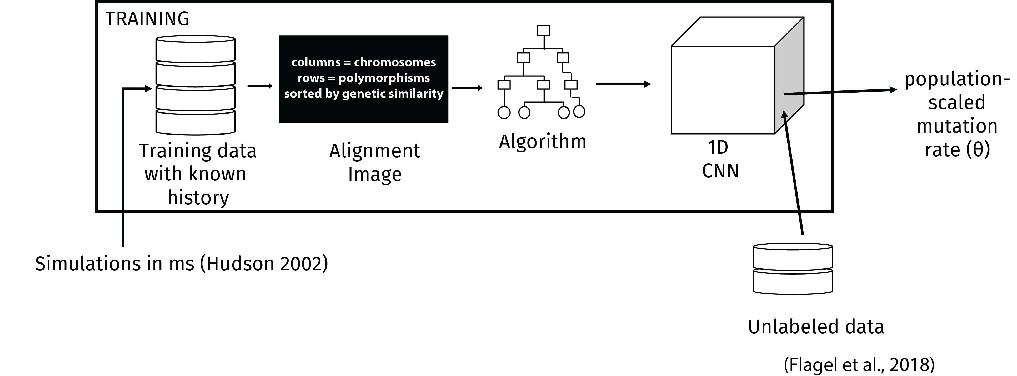
Examples from Flagel et al. 2019
Goal: to predict the mutation rate

Slide 42
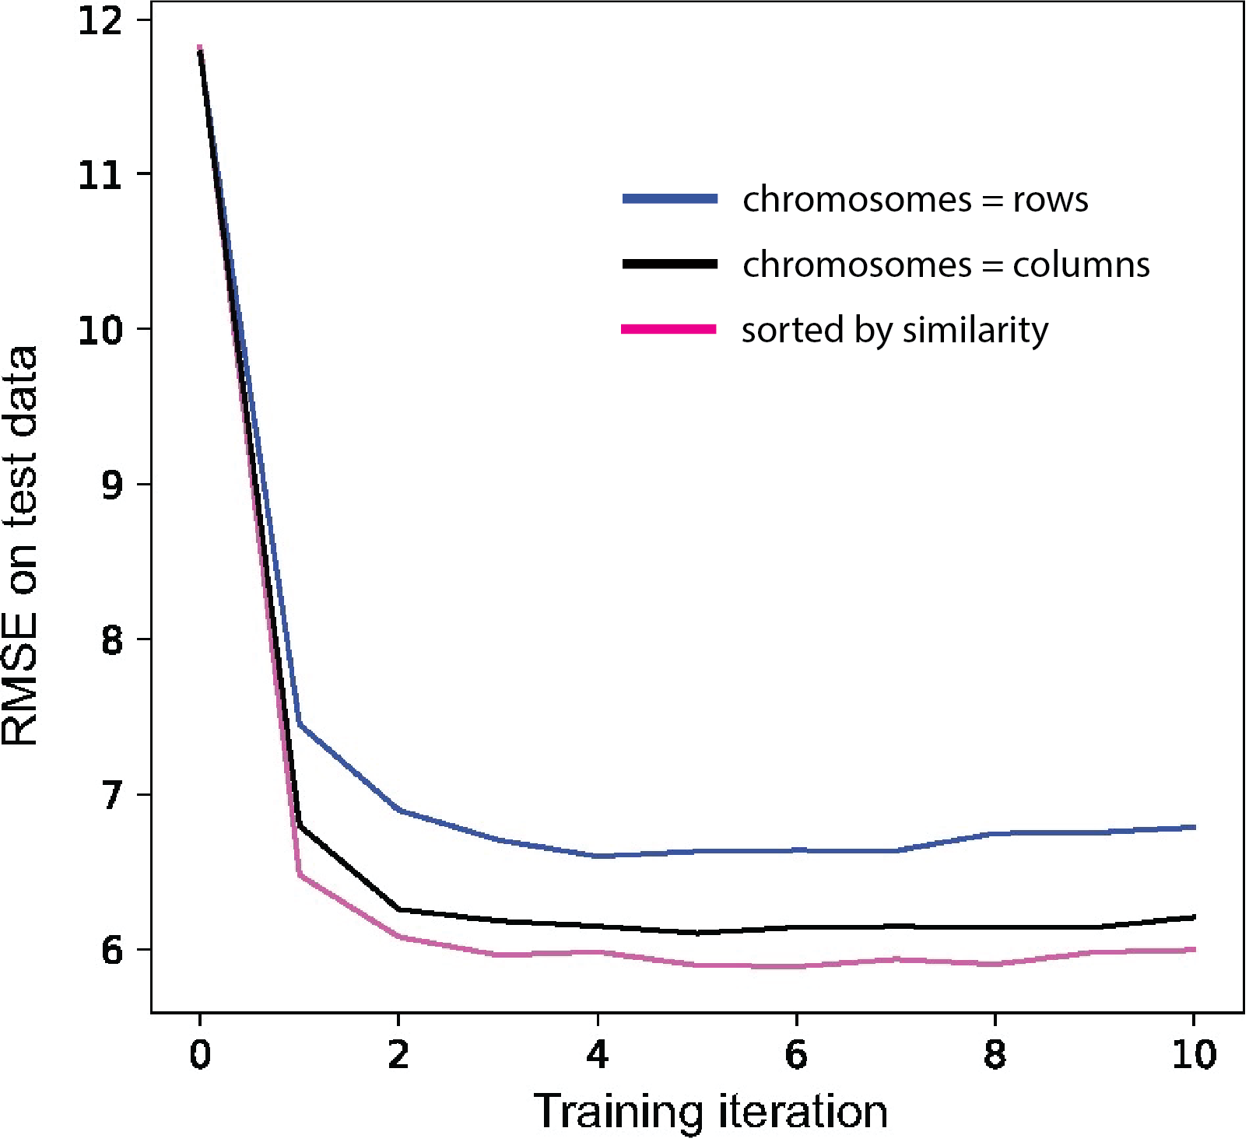
Examples from Flagel et al. 2019
Goal: to predict the mutation rate

Slide 43
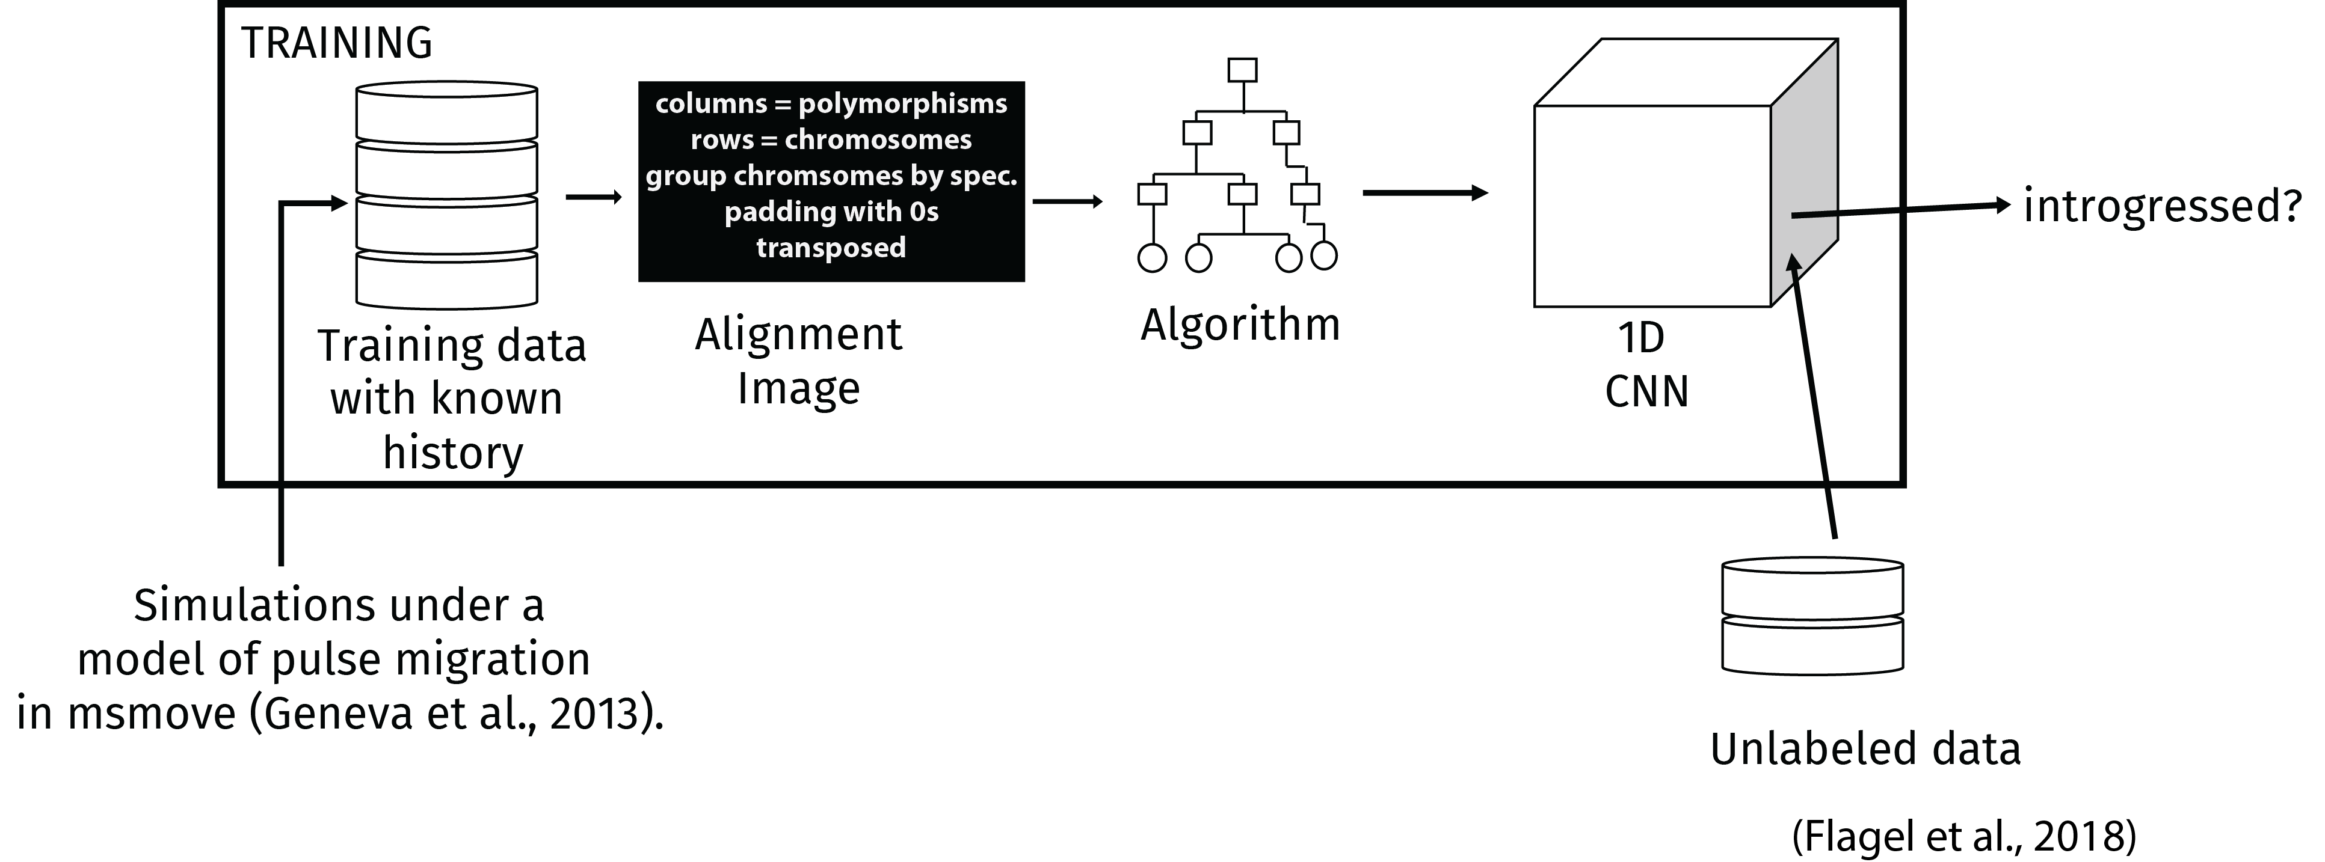
Examples from Flagel et al. 2019
Goal: to predict whether a genomic region is introgressed

Slide 44
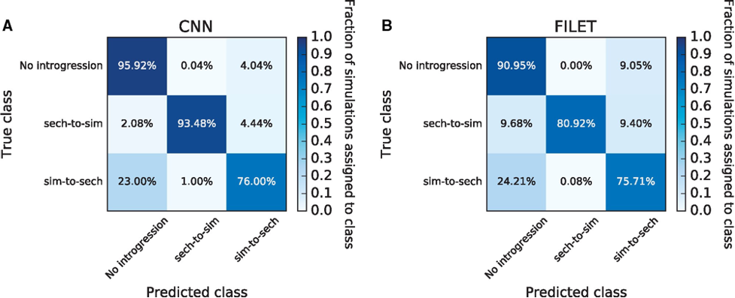
Examples from Flagel et al. 2019
Goal: to predict whether a genomic region is introgressed
FILET: an ExtraTrees classifier (~RF)

Slide 45
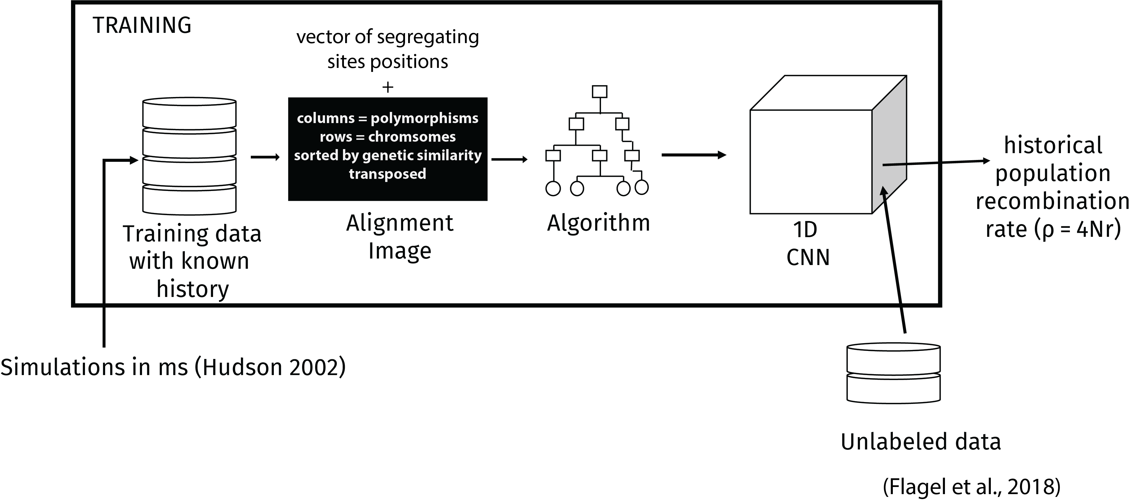
Examples from Flagel et al. 2019
Goal: to infer the recombination rate

Slide 46
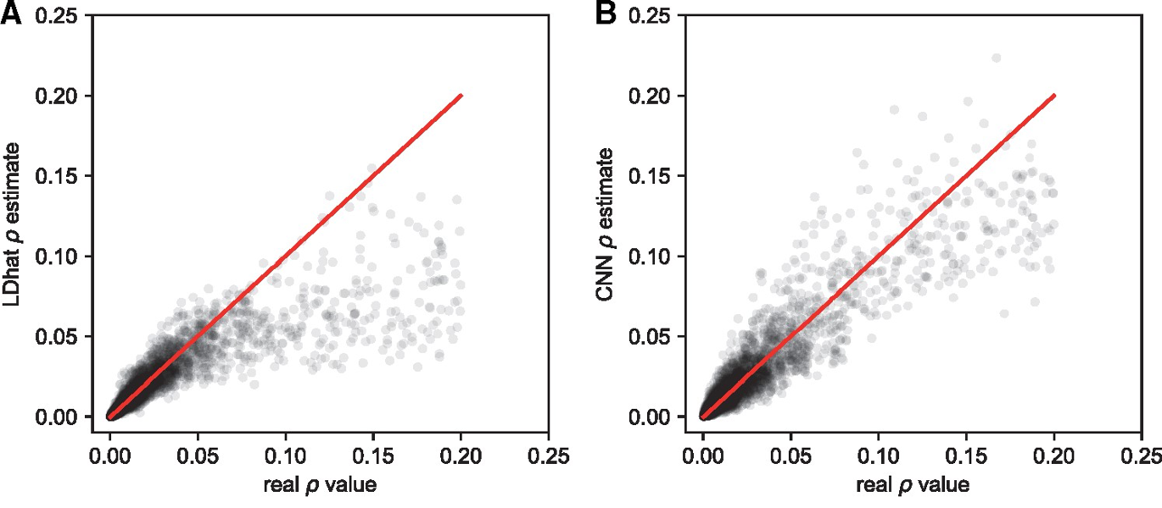
Examples from Flagel et al. 2019
Goal: to infer the recombination rate

Slide 47
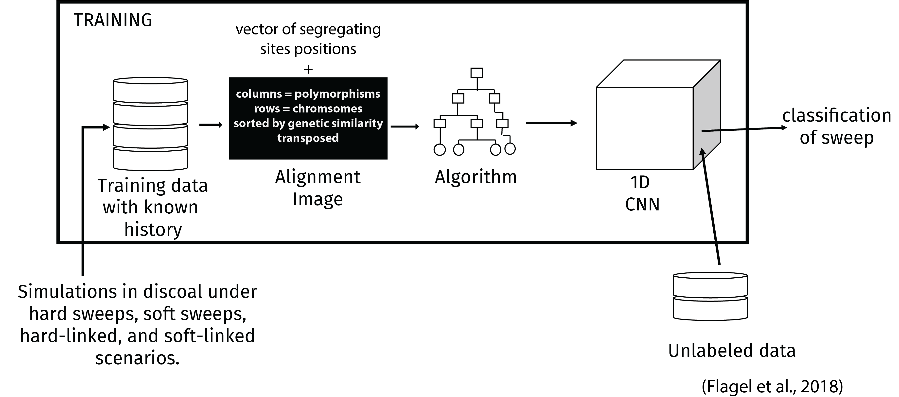
Examples from Flagel et al. 2019
Goal: to detect selection

Slide 48
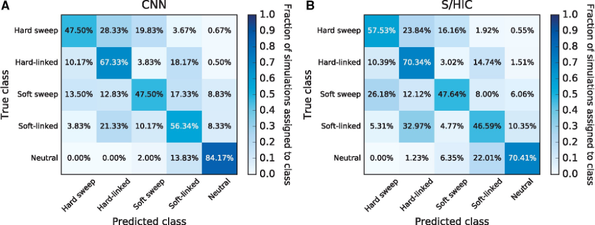
Examples from Flagel et al. 2019
S/HIC: ExtraTrees Classifier
Goal: to detect selection

Slide 49
CNNs in Phylogenetics
CNNs have also been used in phylogenetics
To infer tree topologies (i.e., relationships among species)
To infer branch lengths
And more!

Slide 50
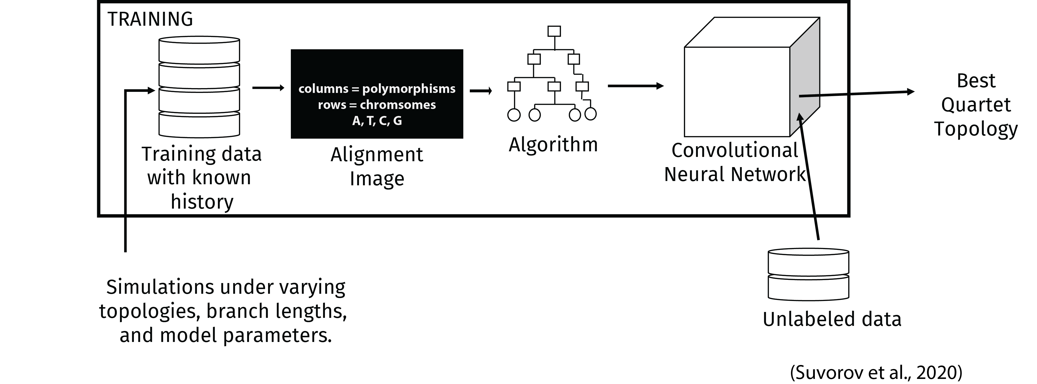
CNNs in Phylogenetics
Goal: To infer relationships among species (i.e., tree topologies)

Slide 51
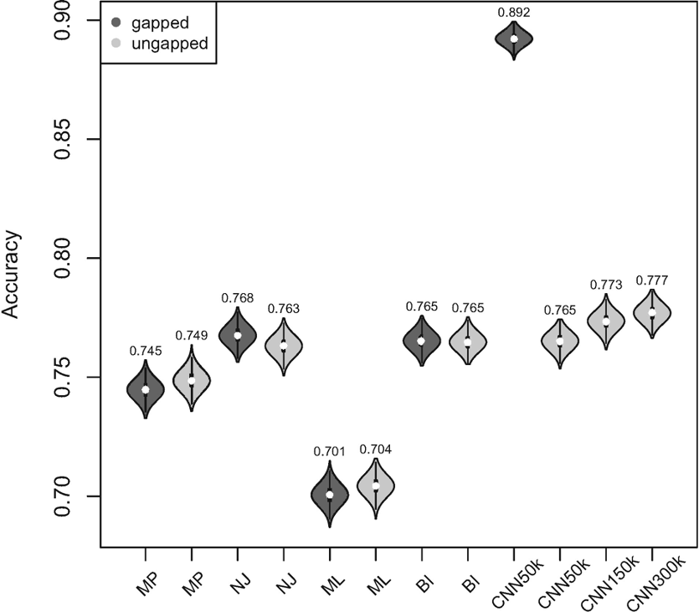
CNNs in Phylogenetics
Goal: To infer relationships among species (i.e., tree topologies)

Slide 52
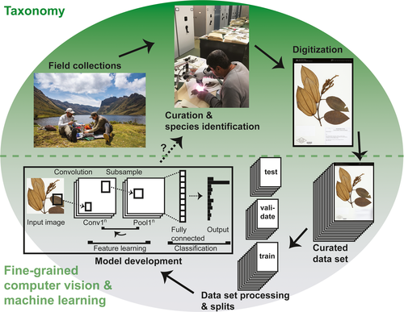
CNN for species identification
Little et al., 2020

Slide 53
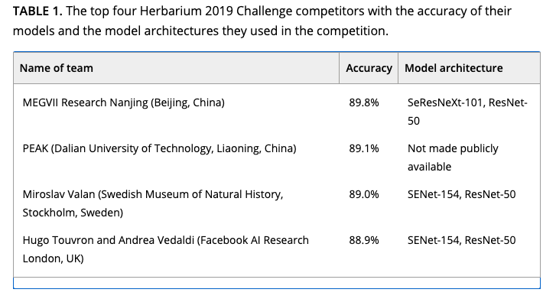
CNN for species identification
Little et al., 2020

Slide 54
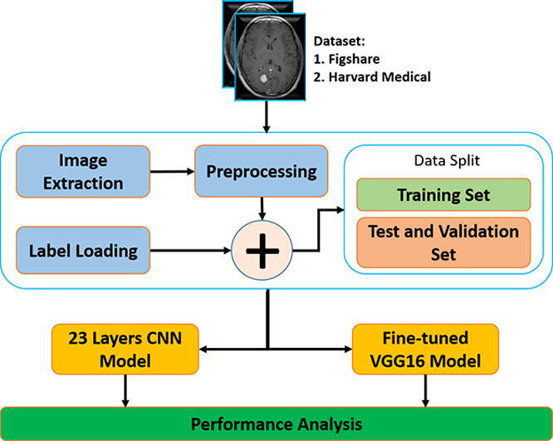
CNN for tumor detection

Slide 55
CNN for tumor detection

Slide 56
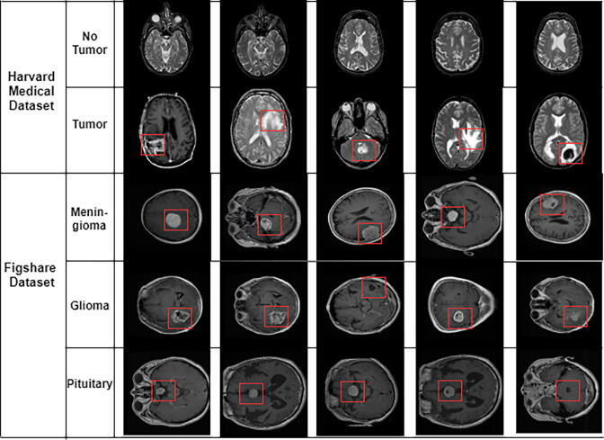
CNN for tumor detection

Slide 57
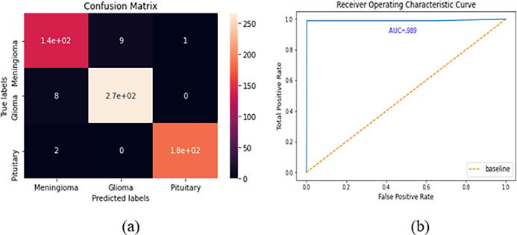
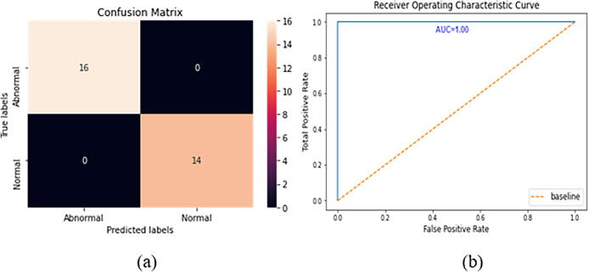
CNN for tumor detection

Slide 58
Convolutional Neural Networks
Take images directly as input.
Bypass the need to summarize data.
Have even more hyperparameters than a fully-connected neural network.

